Slide 1
PATA MICRONESIA CHAPTER
CULTURE HERITAGE & ENVIRONMENT COMMITTEE REPORT
GENERAL MEMBERSHIP MEETING
DECEMBER 9, 2022
RITA PANGELINAN NAUTA, CHAIR SANDRA ISEKE OKADA, CO-CHAIR

Slide 2
2021 APPROVED BUDGET - $600
Carry Over 2022
VOYAGE TO RECOVERY:
PUBLIC EDUCATION & OUTREACH SERIES - $400
TECHNICAL & PRODUCTION FEES - $200

Slide 3
2021/2022 VOYAGE TO RECOVERY PLAN:
PARTNER & LEVERAGE RESOURCES
Assist PR Committee with content development for newsletters and #MicrONEsia
Collaborate with Community & Education & Marketing Committees - Outreach Programs
Assist region’s cultural producers in accessing or expanding reach into the online market via Guampedia’s heritage gift shop.

Slide 4
Educational Outreach
Community Collaborations
Promoting MicrONEsia
2021-2022

Slide 5
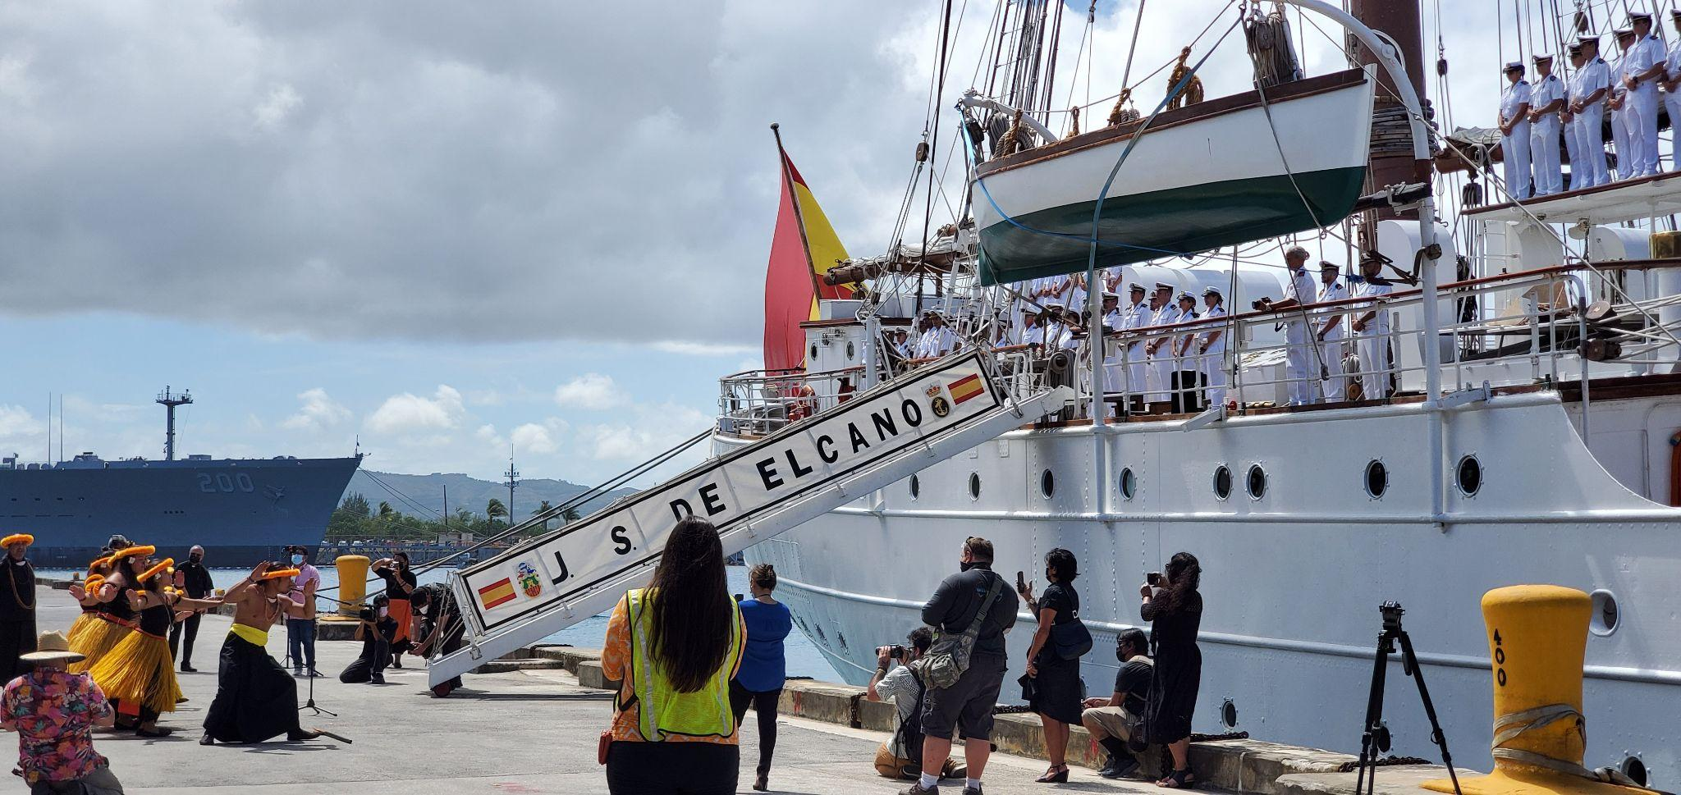
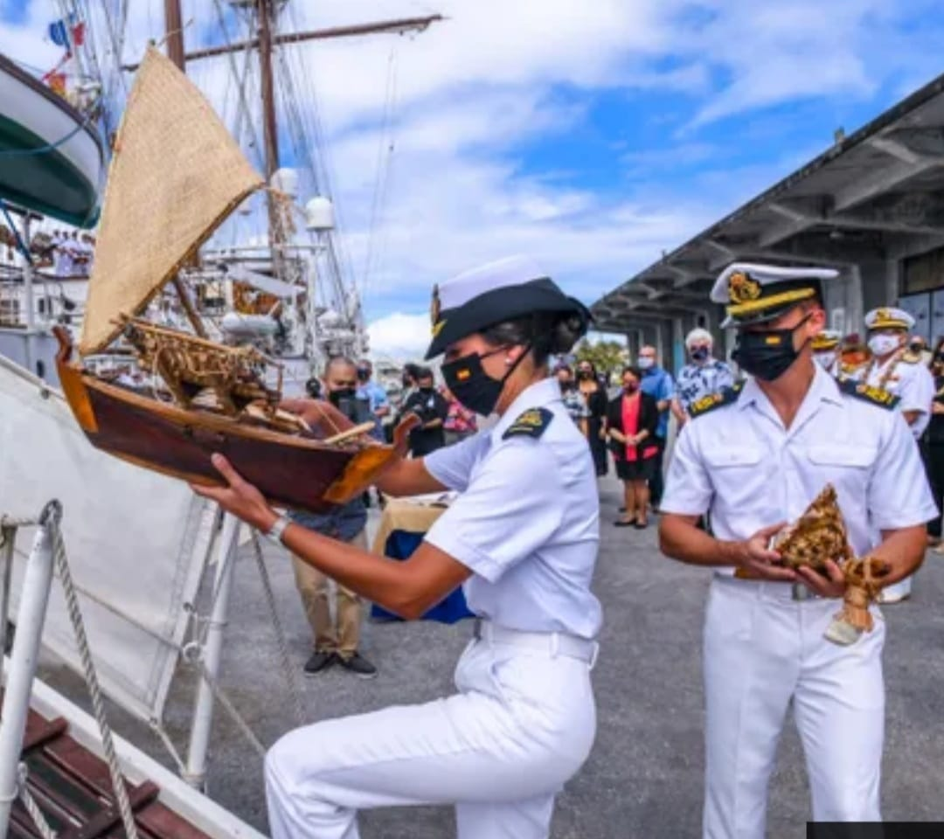
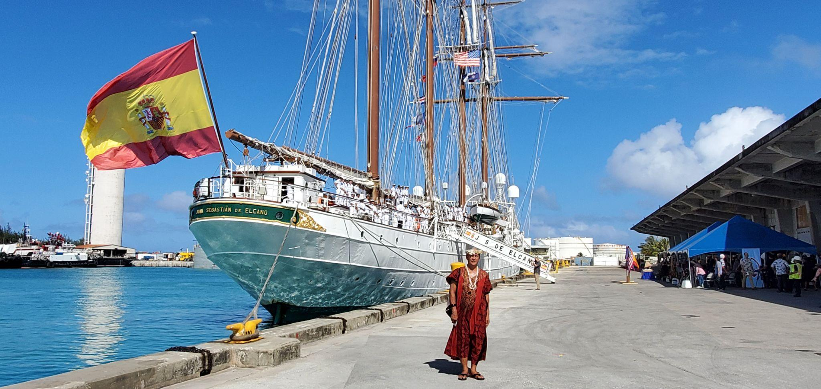
500th Commemoration: 1st Circumnavigation March 6, 2021 - Guam

Slide 6
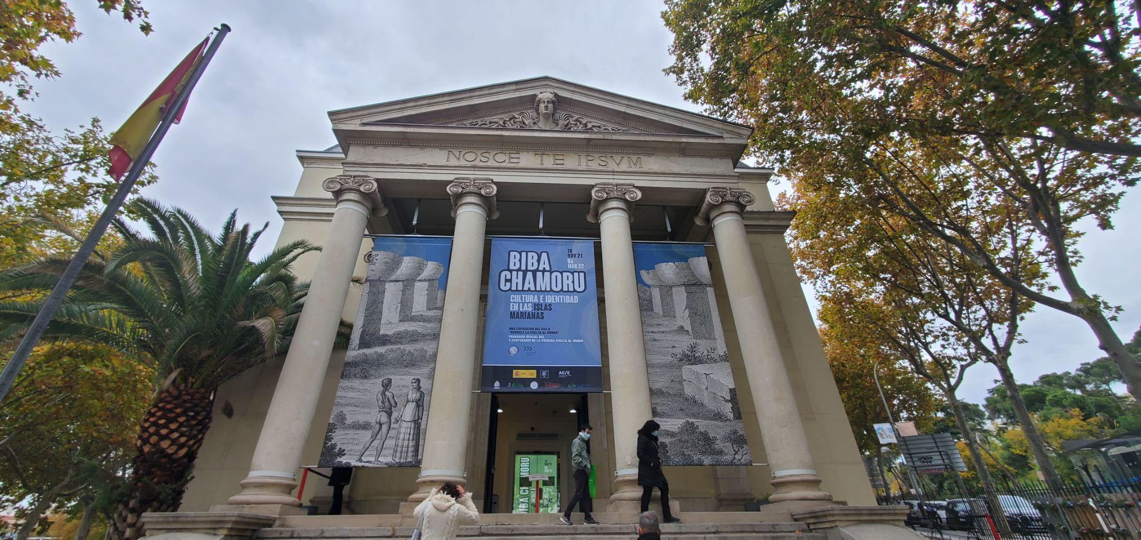
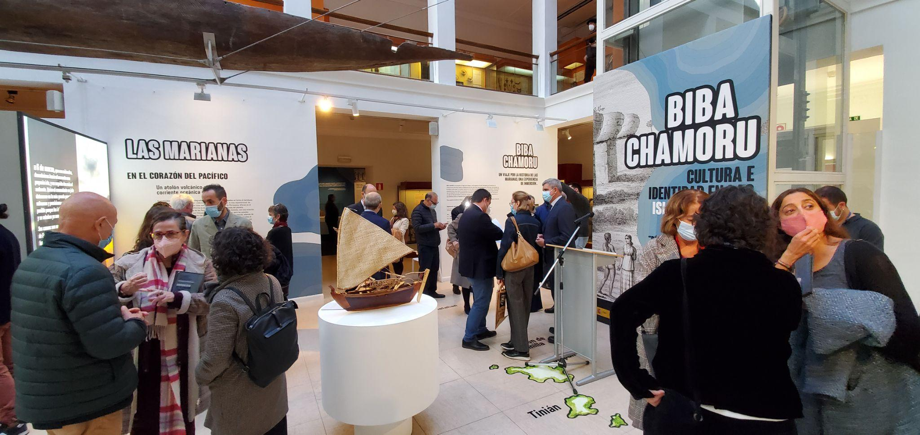
500th Commemoration: 1st Circumnavigation Nov 2021, BIBA CHAMORU Exhibition, Spain

Slide 7
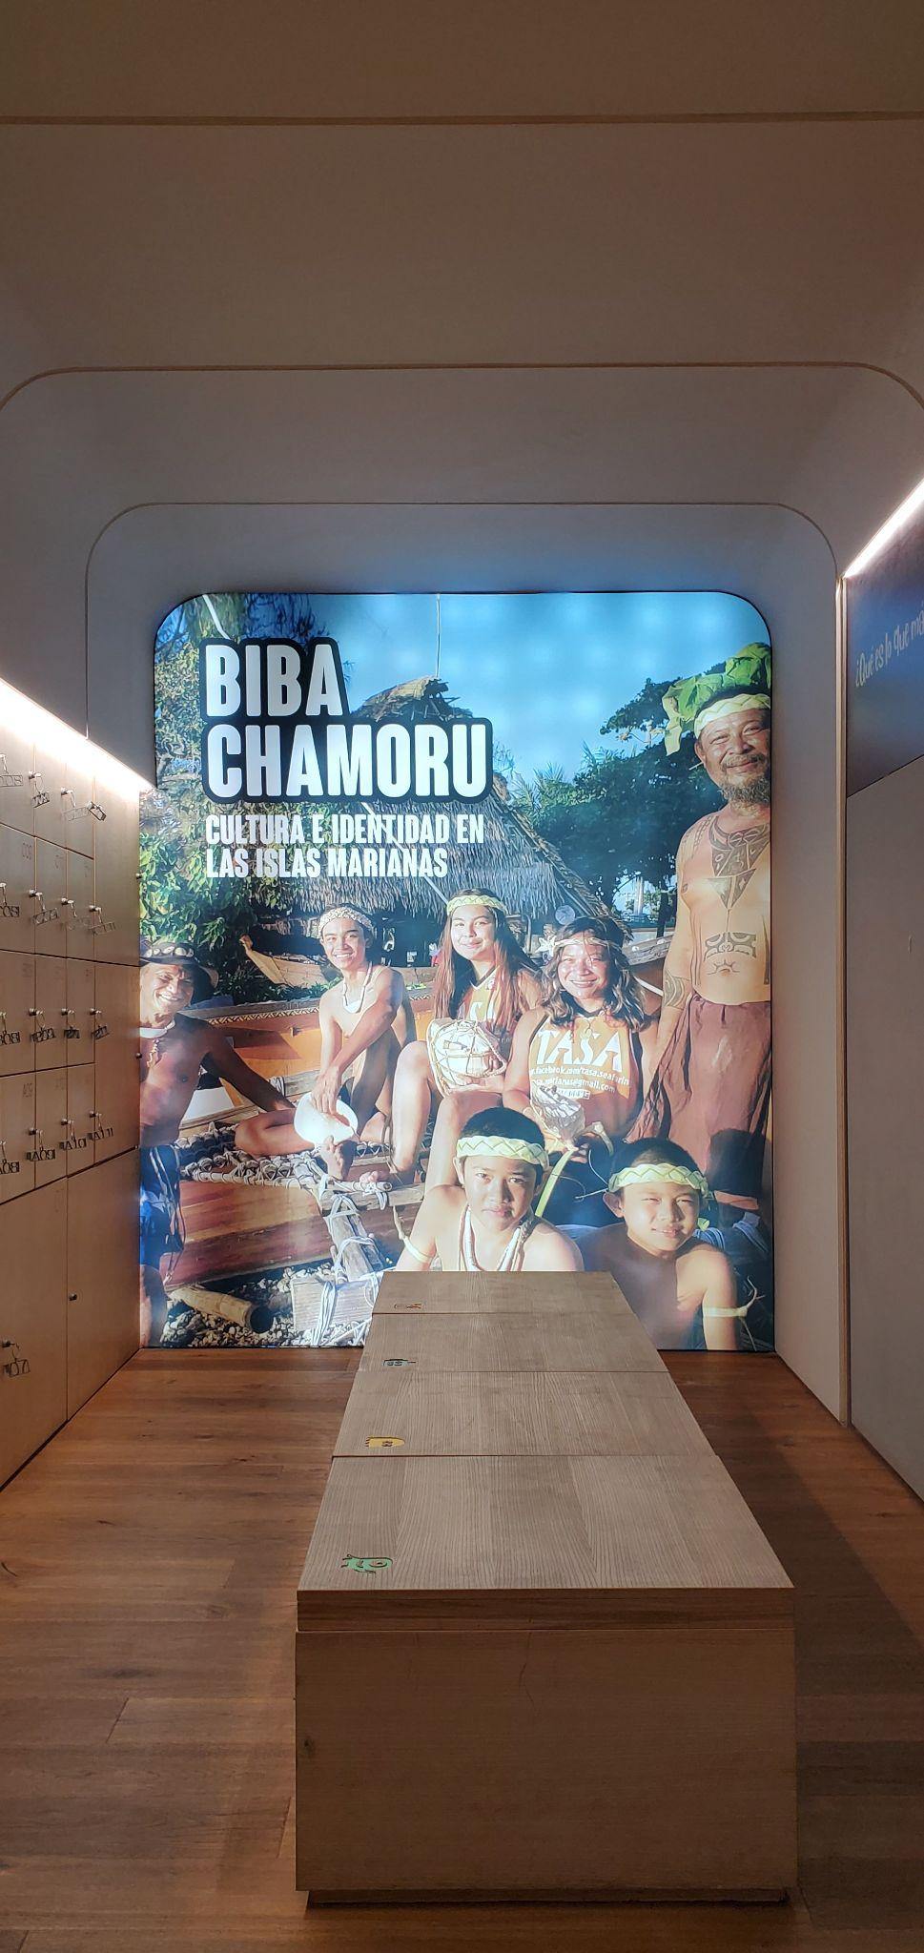
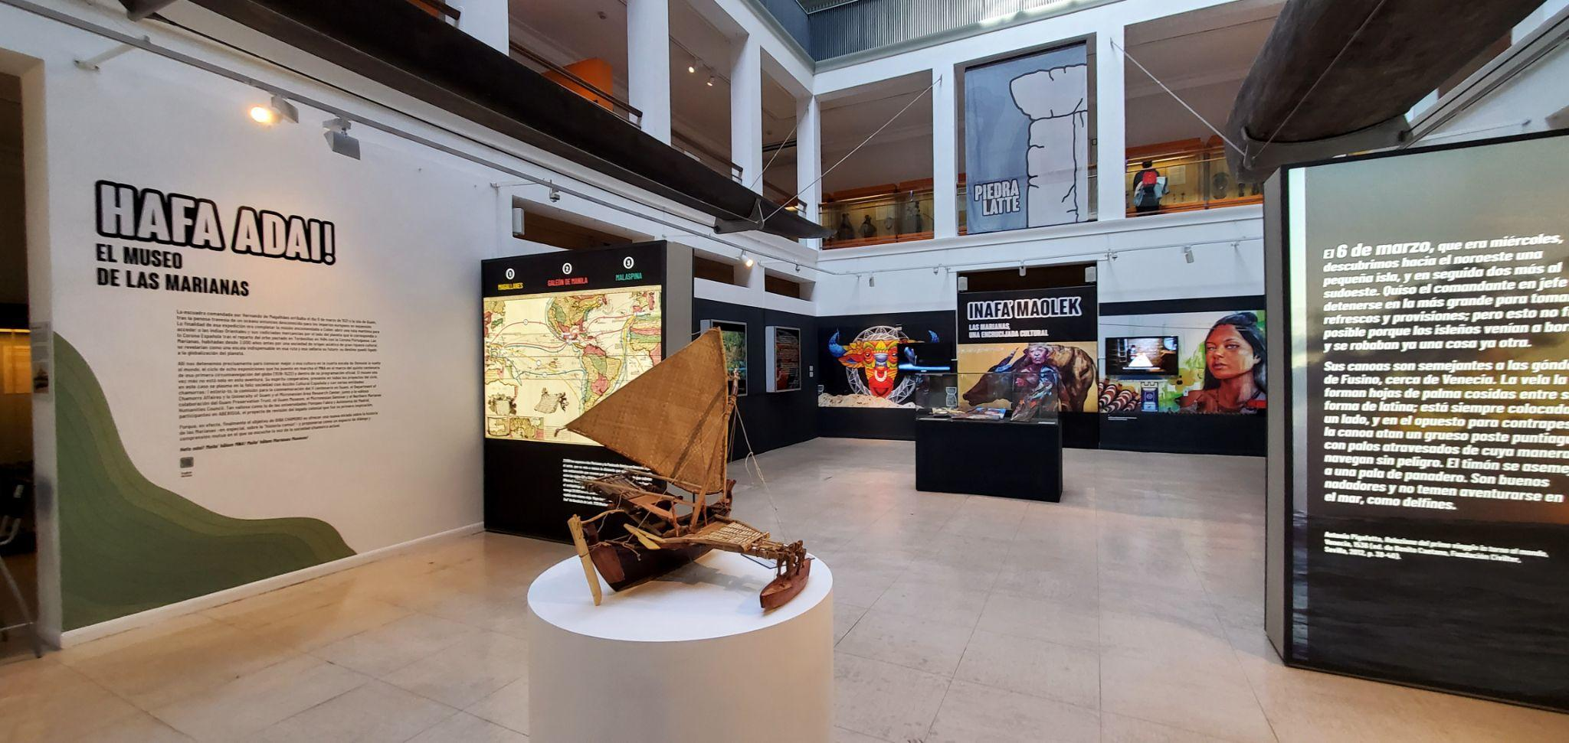
500th Commemoration: 1st Circumnavigation Nov 2021, BIBA CHAMORU Exhibition, Spain

Slide 8
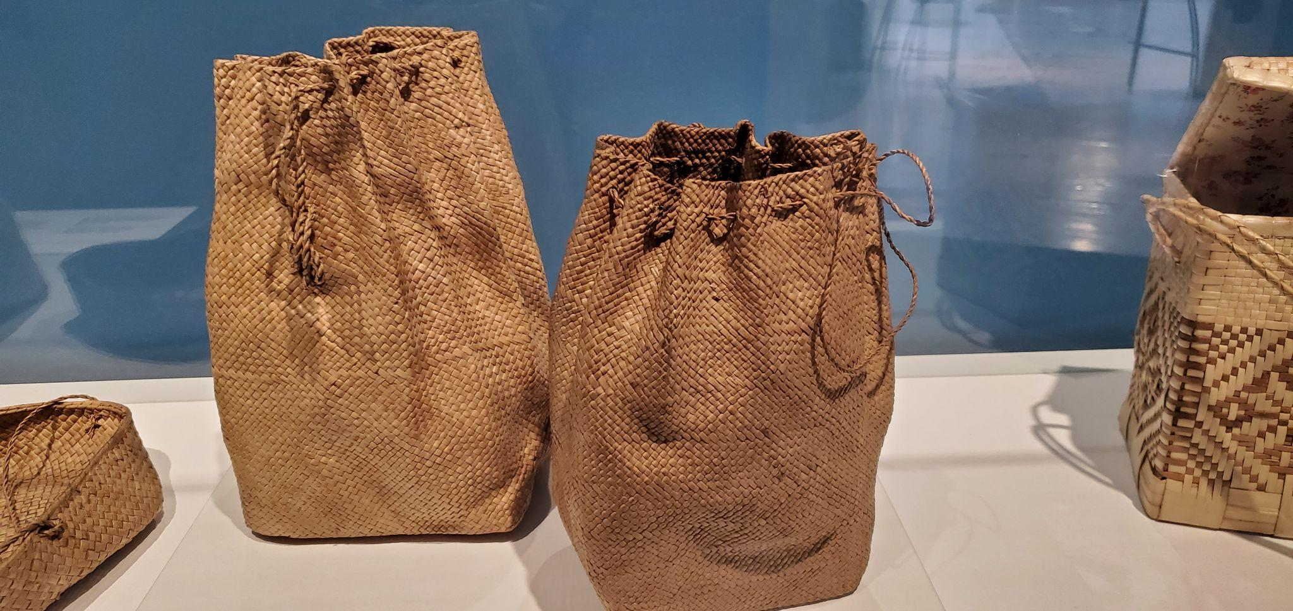
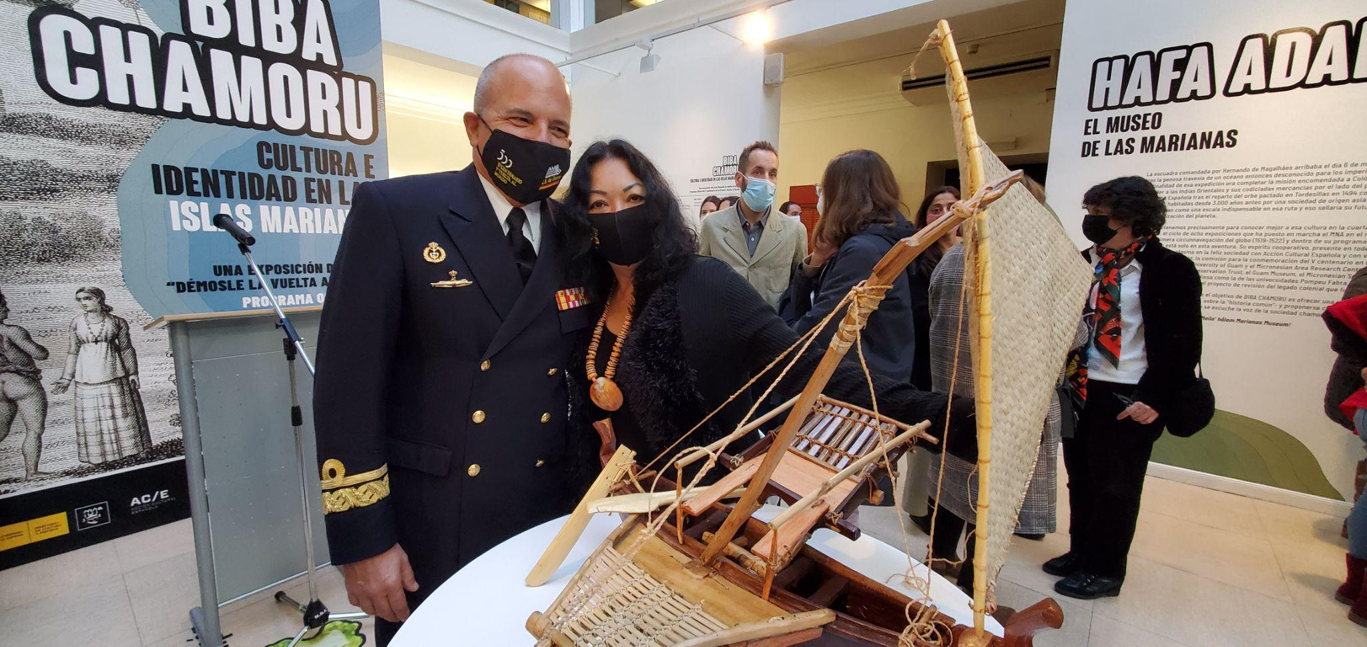
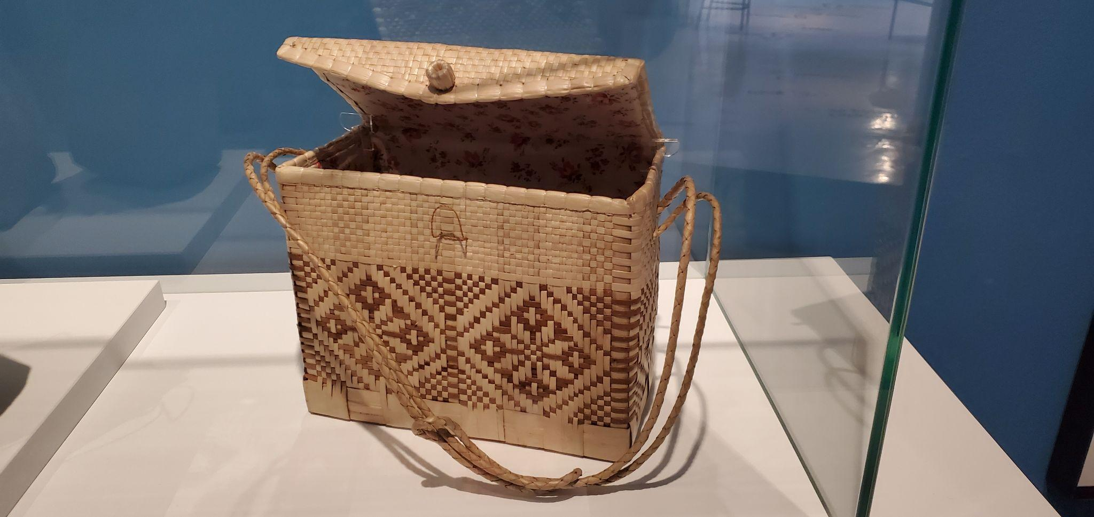
500th Commemoration: 1st Circumnavigation Nov 2021, BIBA CHAMORU Exhibition, Spain

Slide 9
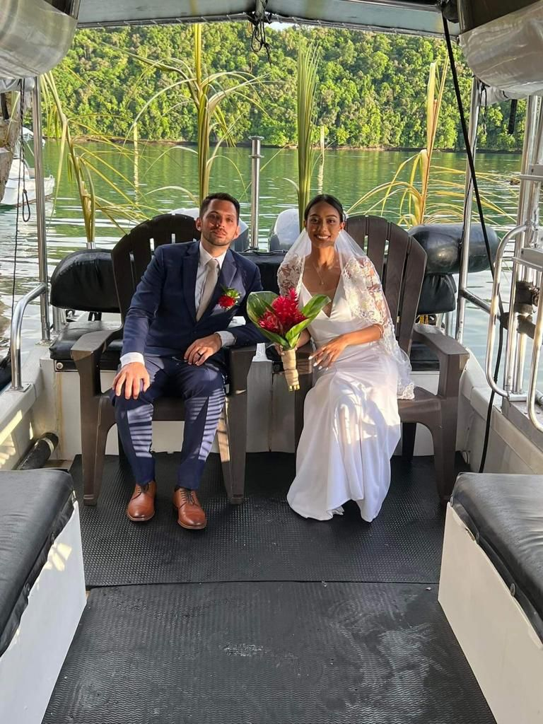
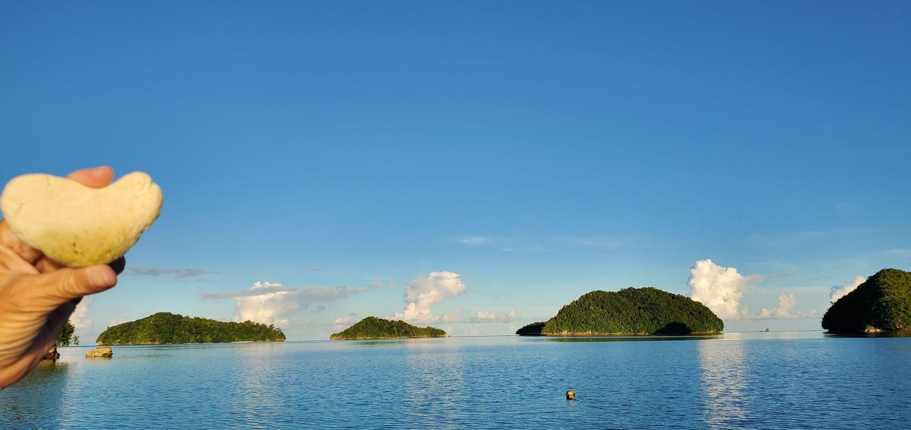
Destination Wedding - Belau May 30 - June 6, 2022, 150 pax

Slide 10
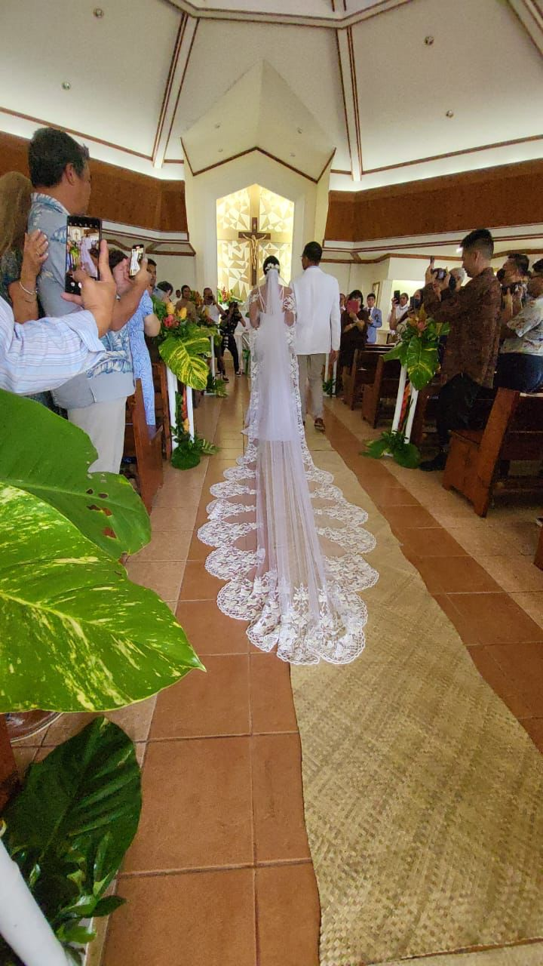
Destination Wedding - Belau May 30 - June 6, 2022, 150 pax

Slide 11
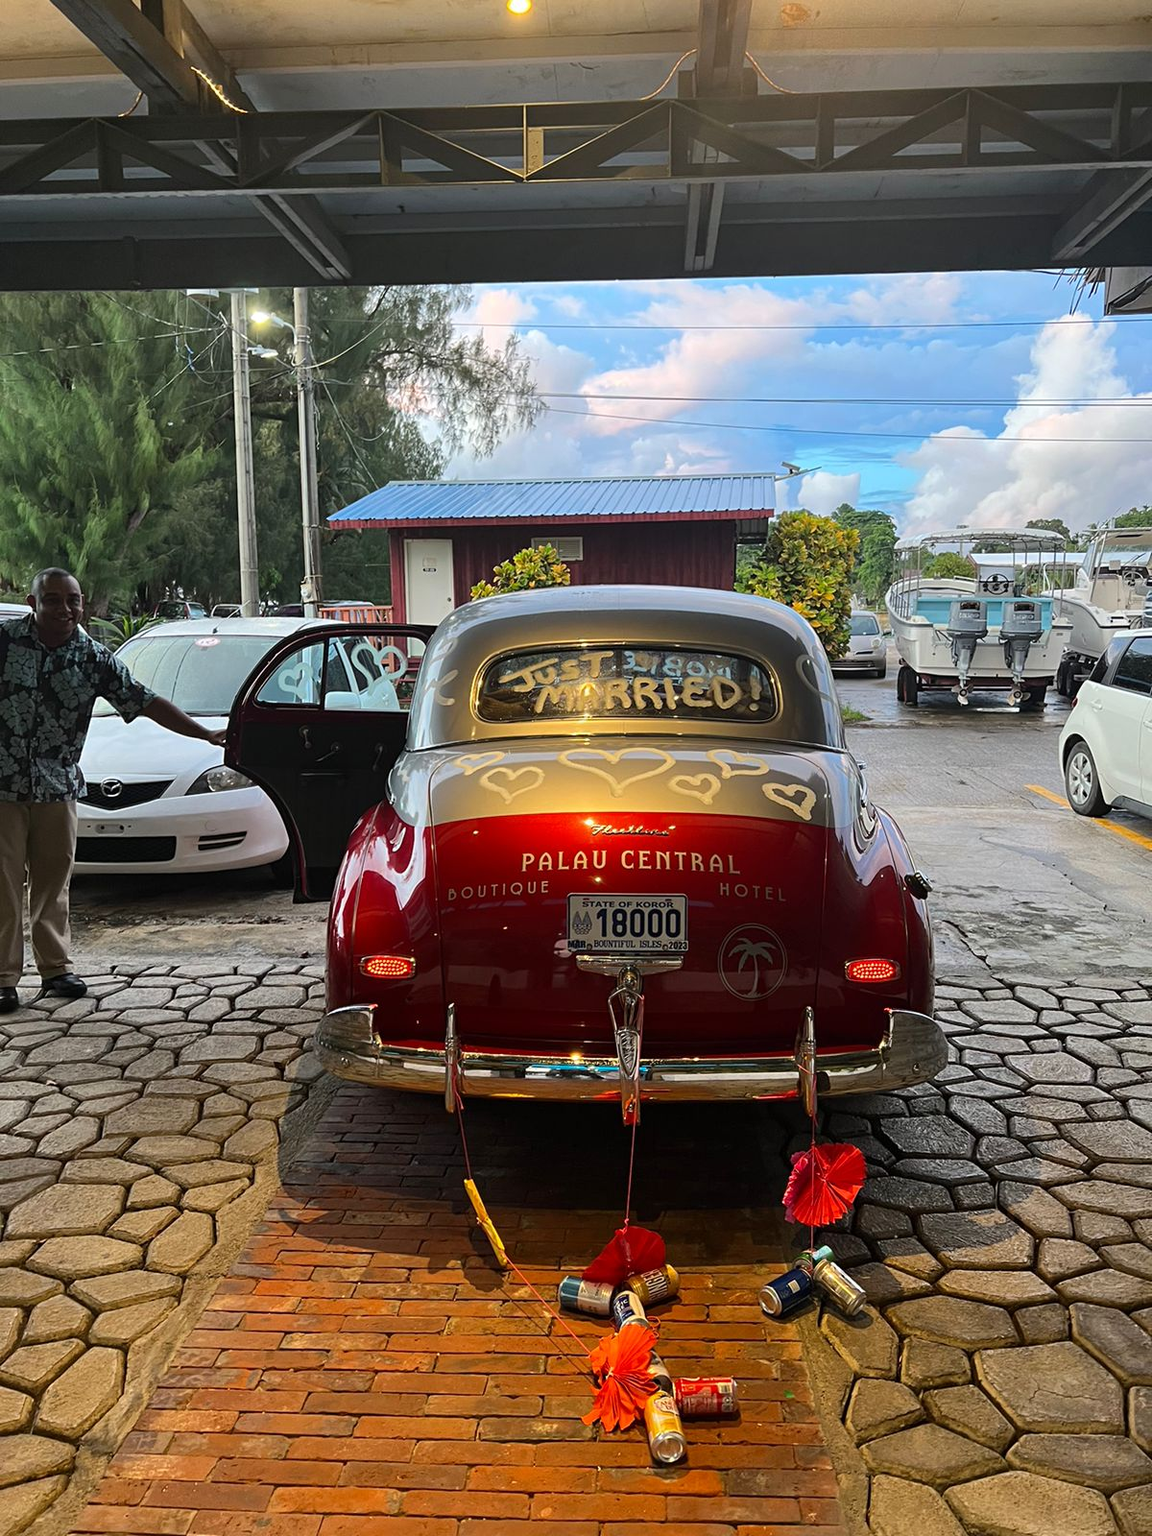
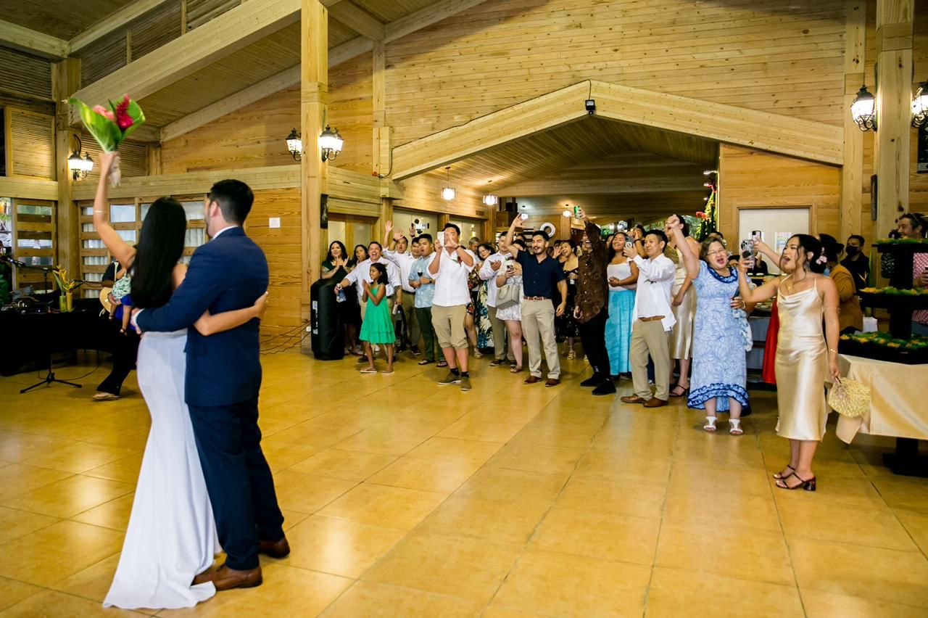
Destination Wedding - Belau May 30 - June 6, 2022, 150 pax

Slide 12
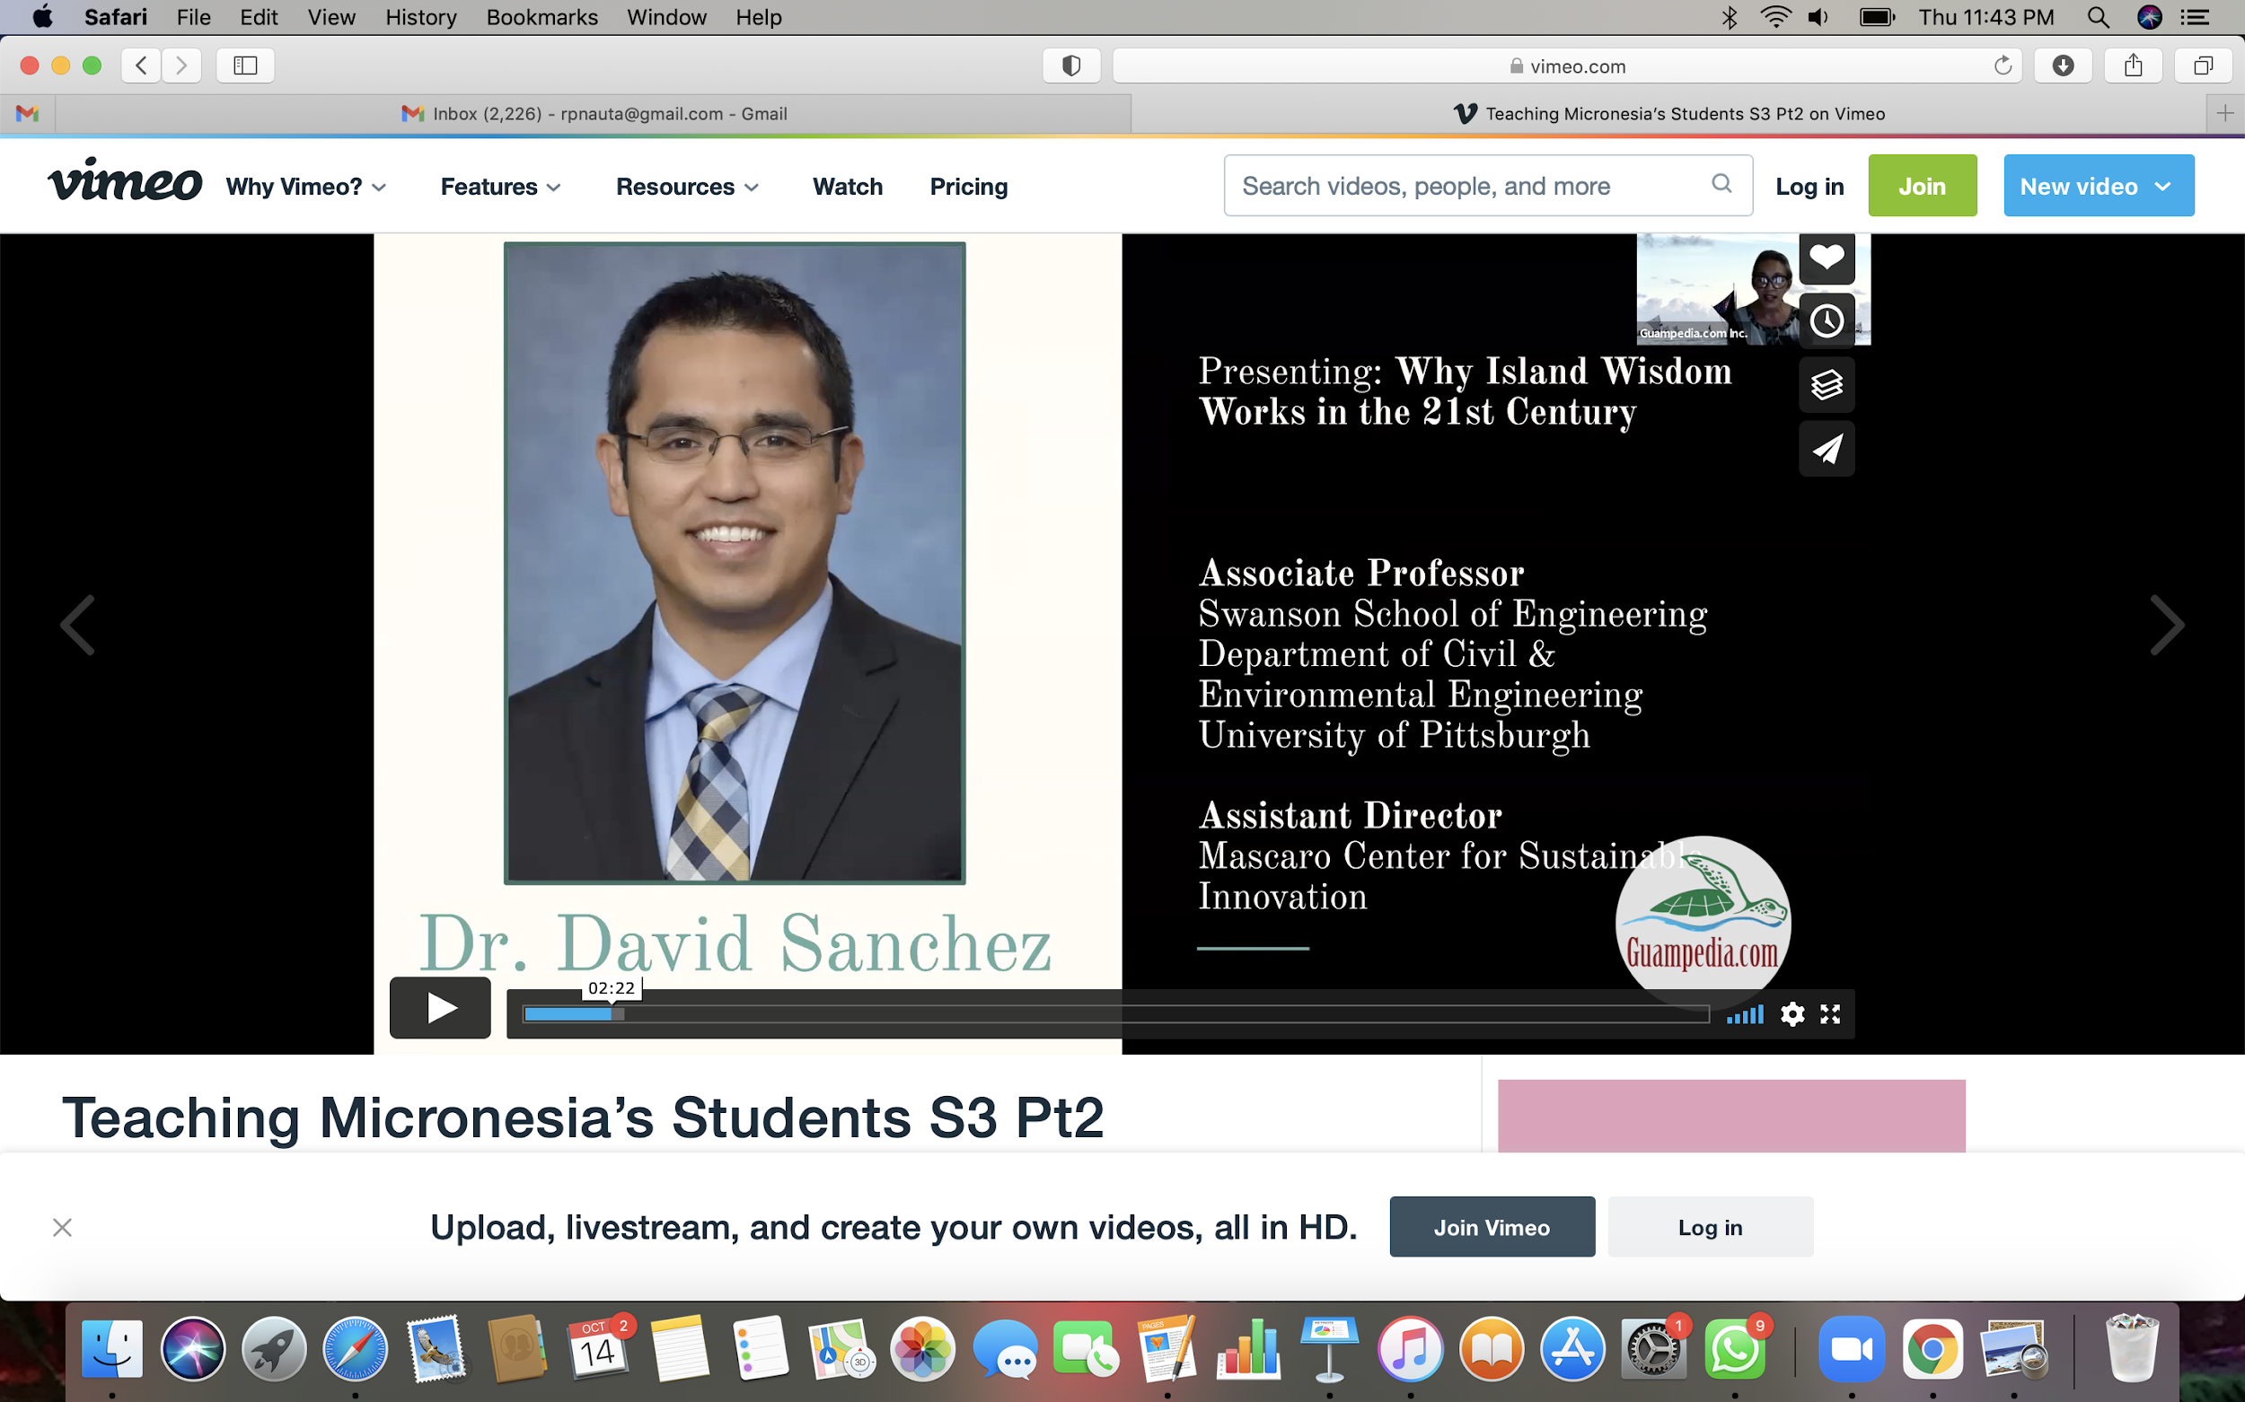
Guampedia Culture of Connecting Series Teaching MicrONEsia’s Students, July 2021

Slide 13
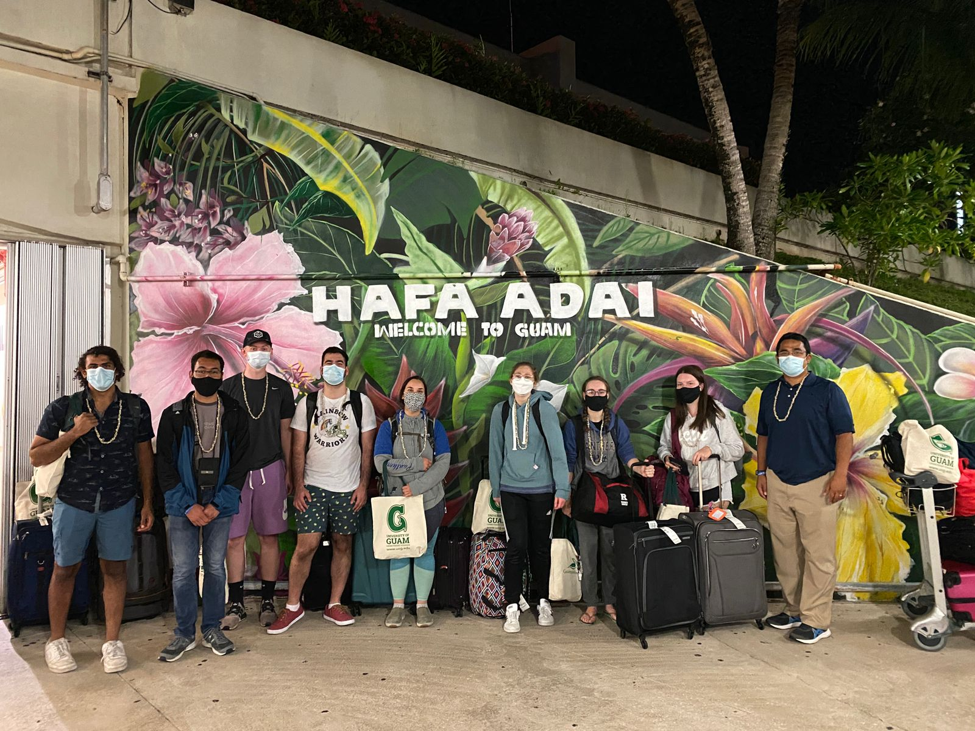
Educational Tourism
2021 Cultural Heritage & Environment Travel Study
University of Pittsburgh Study Away Program: Sustainability of Island Nations - Guam. July 30 - August 13, 2021
Partnership with UPITT, University
of Guam, & Guampedia 10 - UPITT Engineering Students + Professor Sanchez

Slide 14
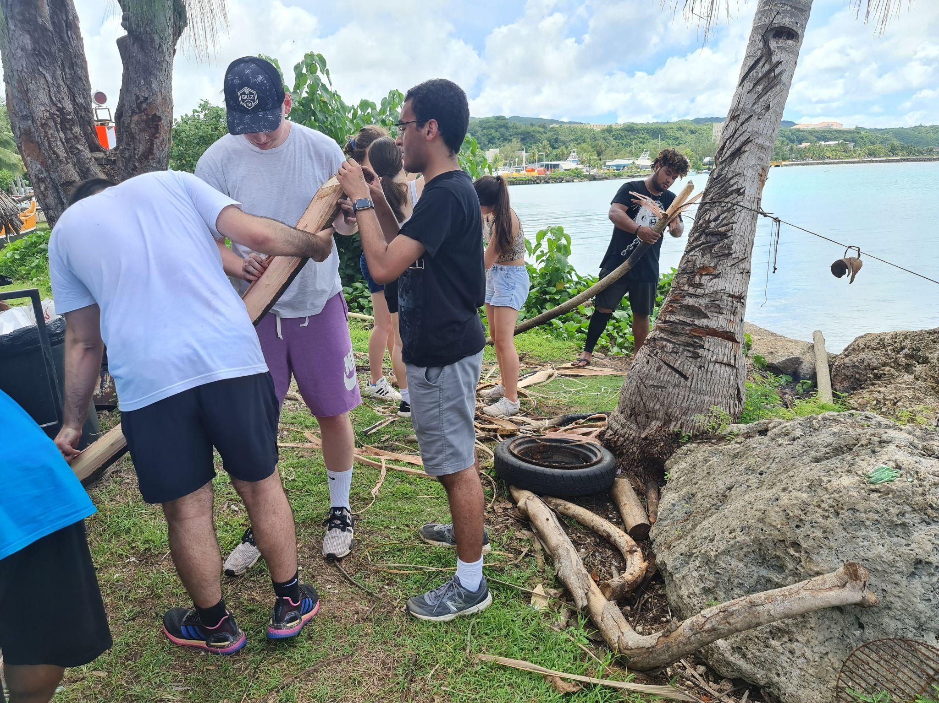
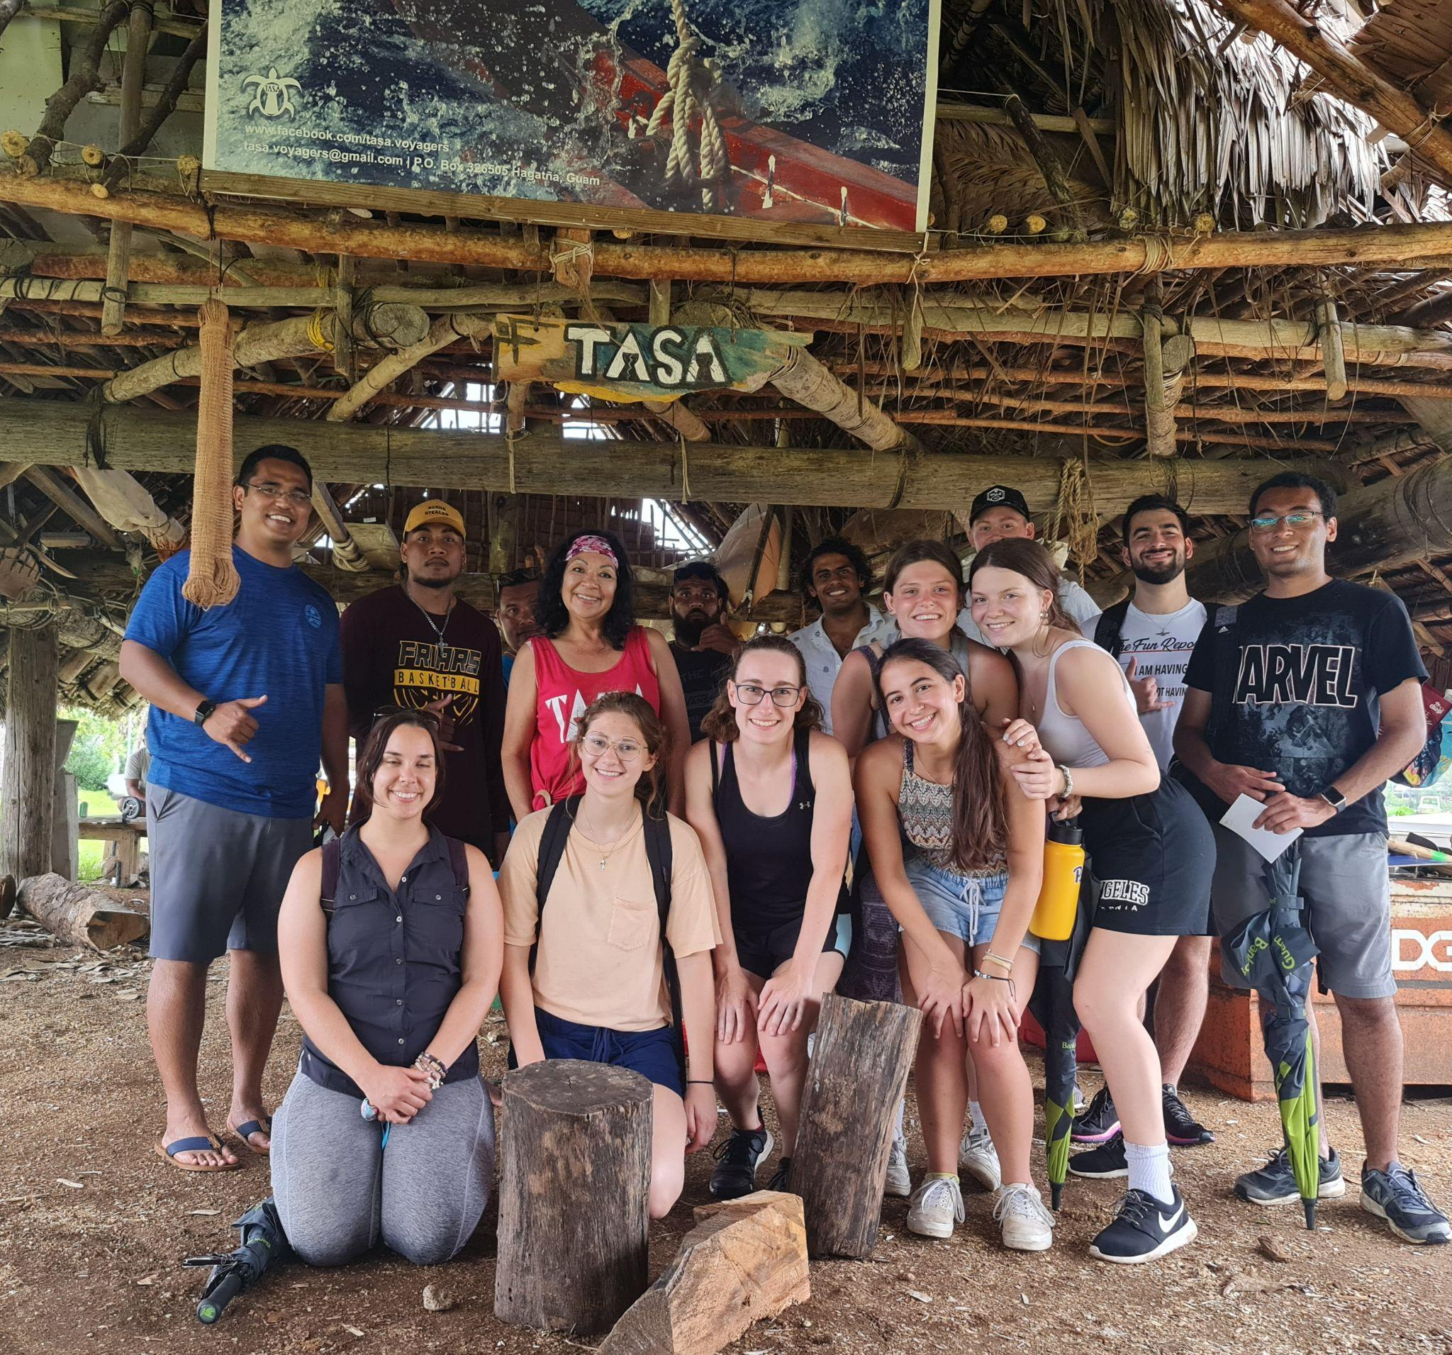
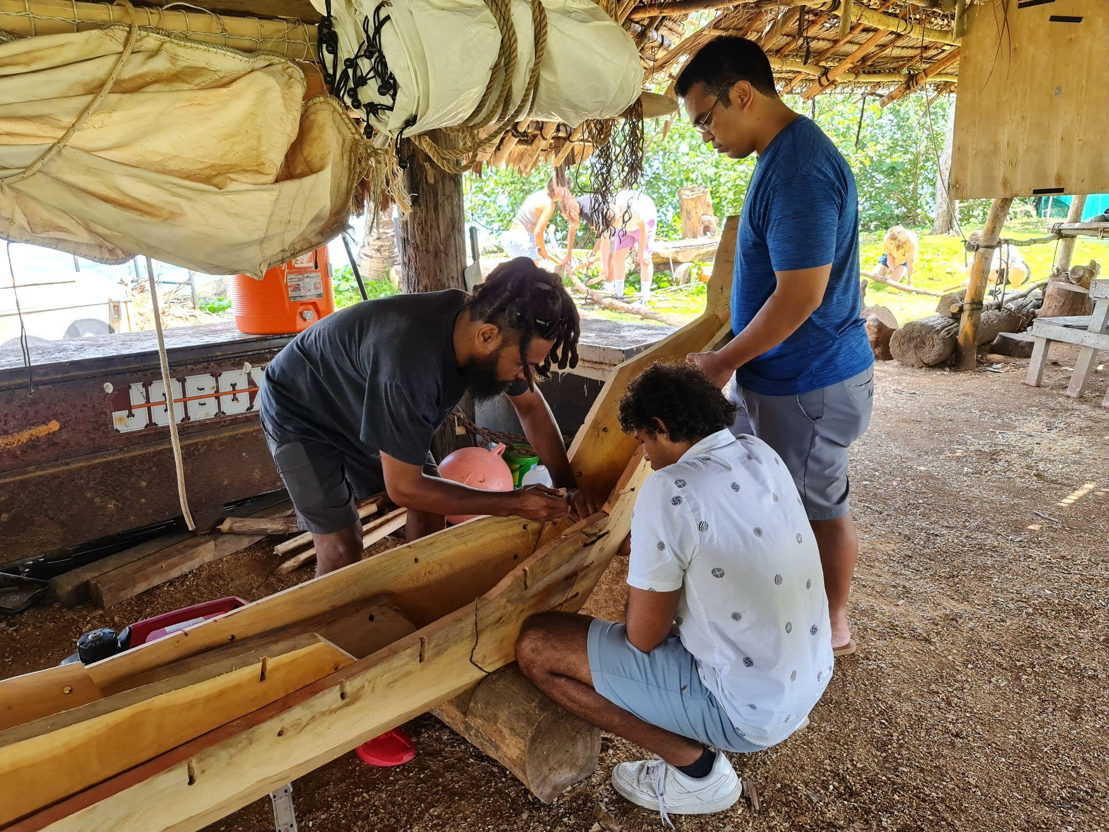
Educational Tourism- University of Pittsburgh
2021 Cultural Heritage & Environment Travel Study

Slide 15
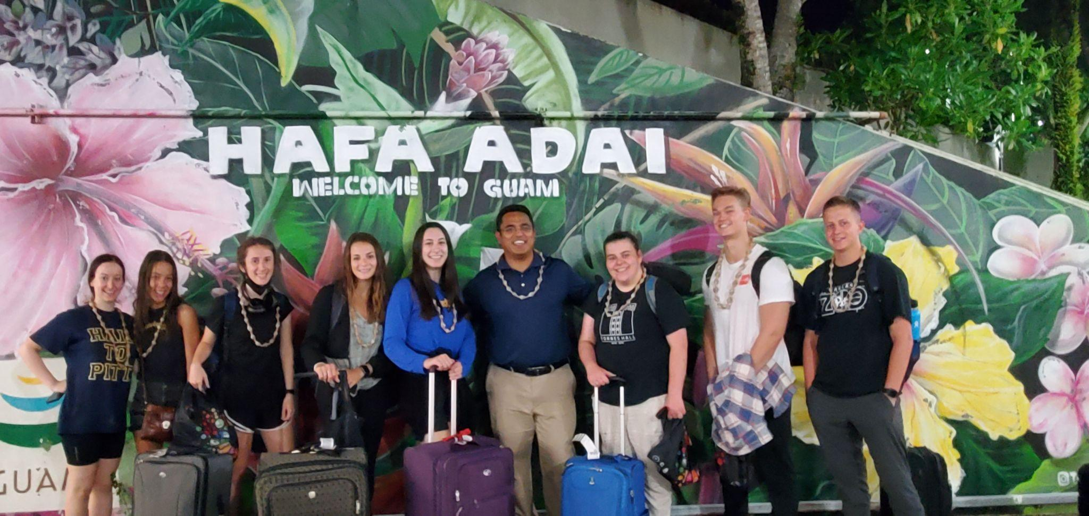
Educational Tourism - University of Pittsburgh
2022 Cultural Heritage & Environment Travel Study

Slide 16
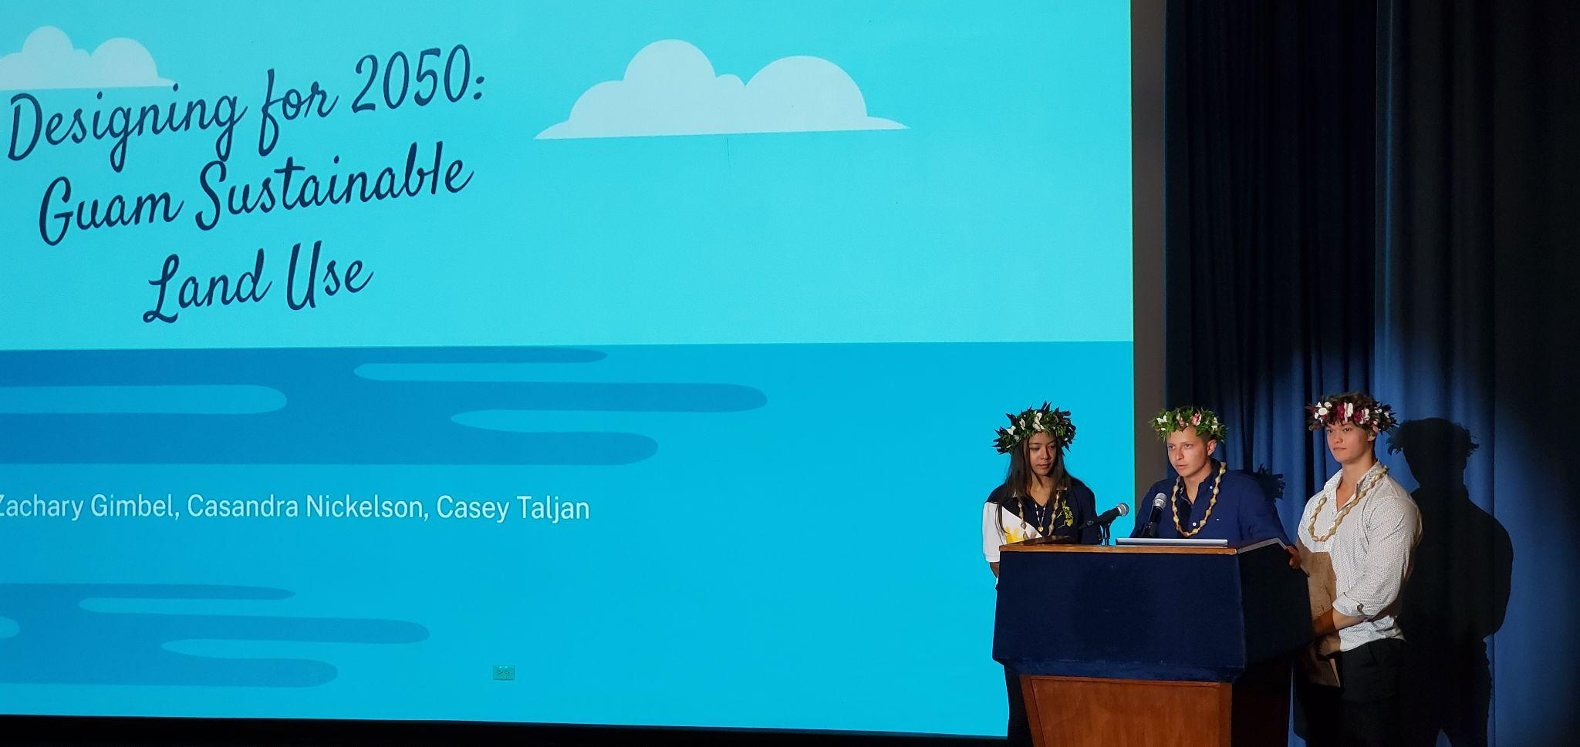
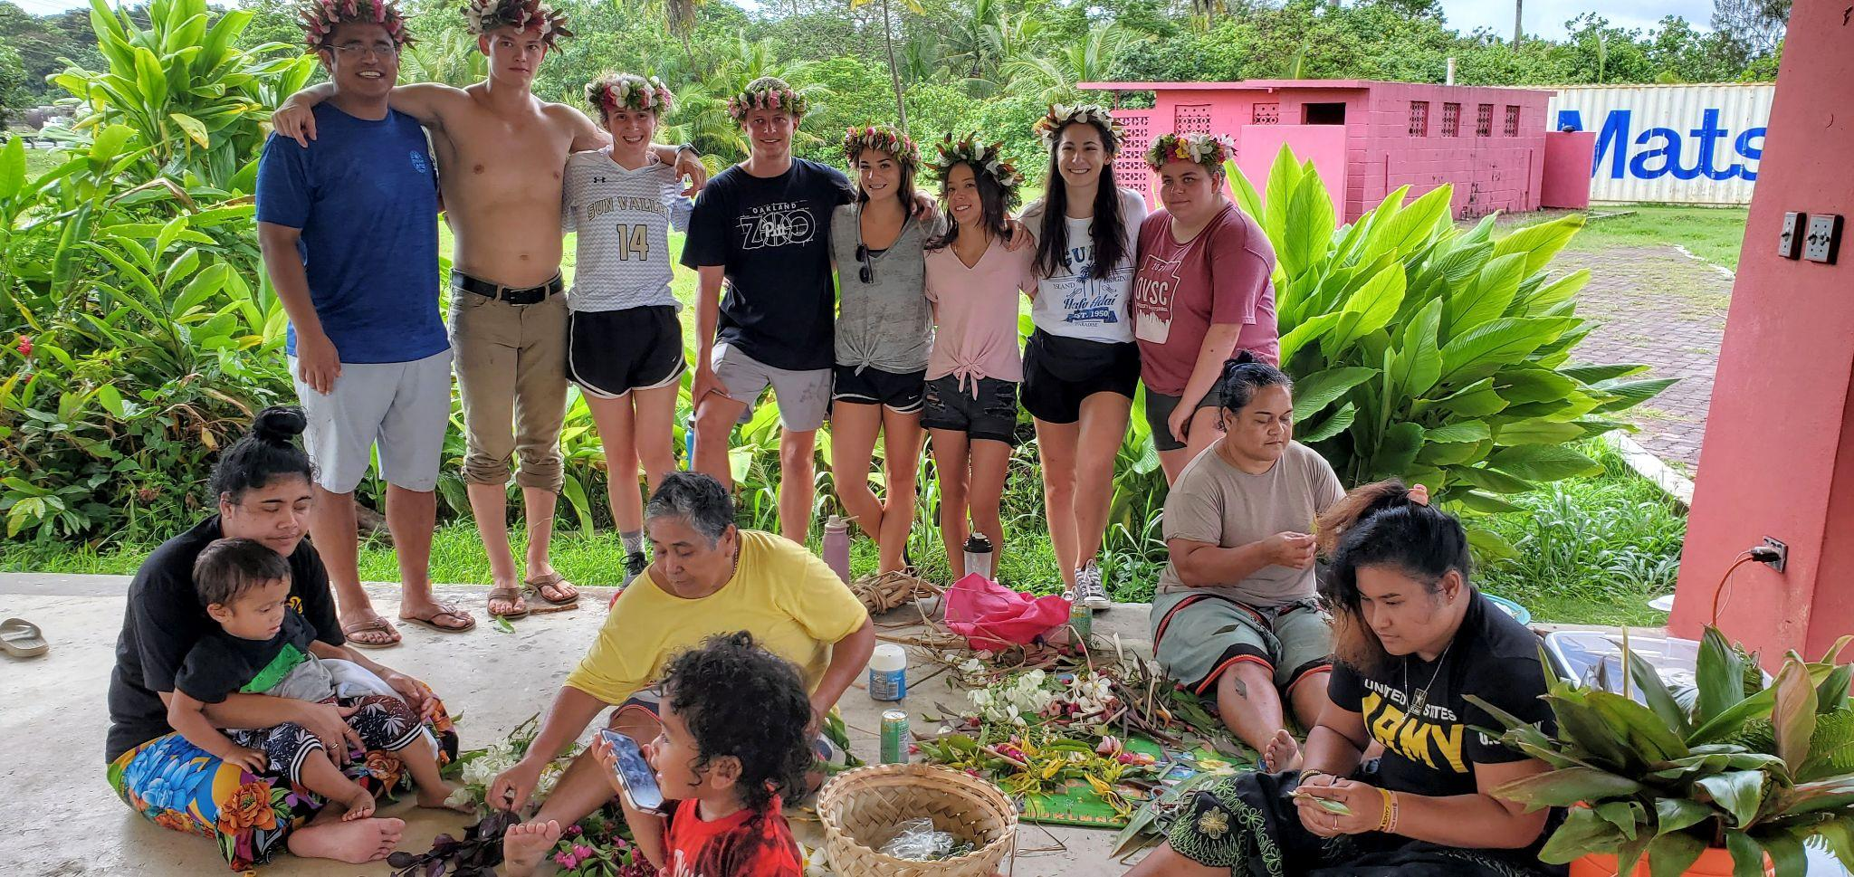
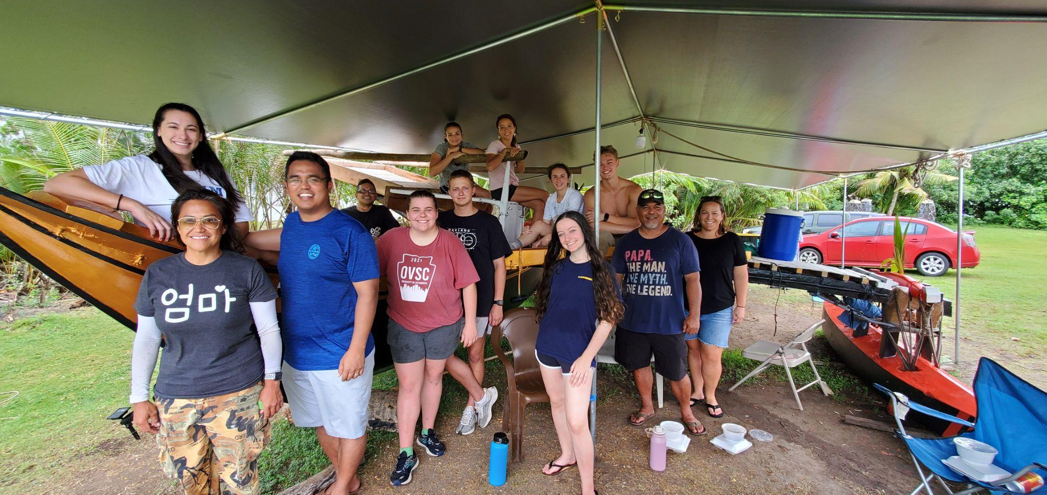
Educational Tourism
2022 Cultural Heritage & Environment Travel Study

Slide 17
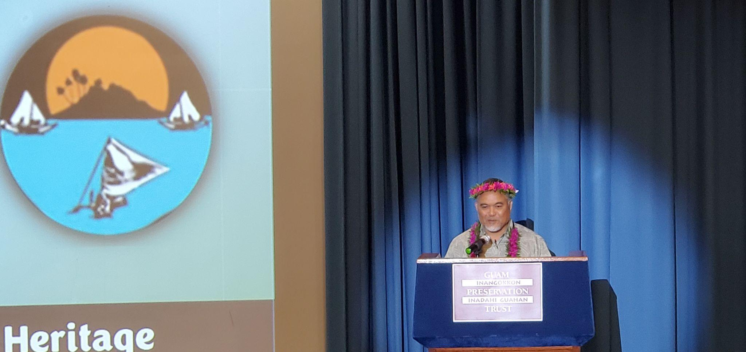
2nd Pacific Preservation Summit
May 24-26, 2022, Guam
Technology Empowering
Cultural
Heritage

Slide 18
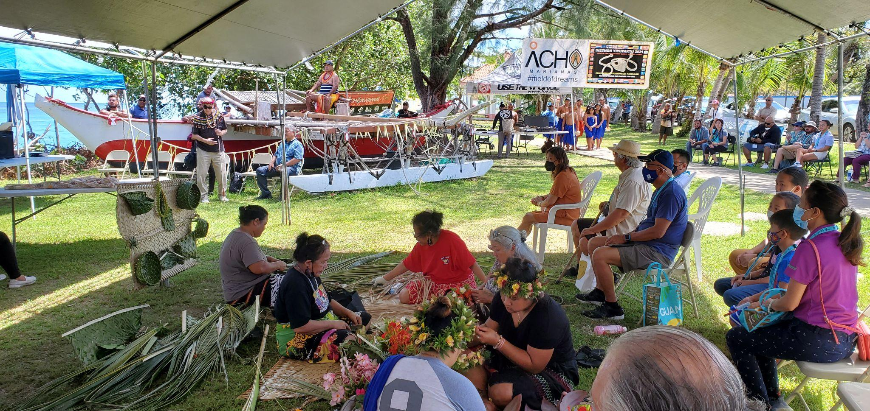
2nd Pacific Preservation Summit
May 24-26, 2022, Guam

Slide 19
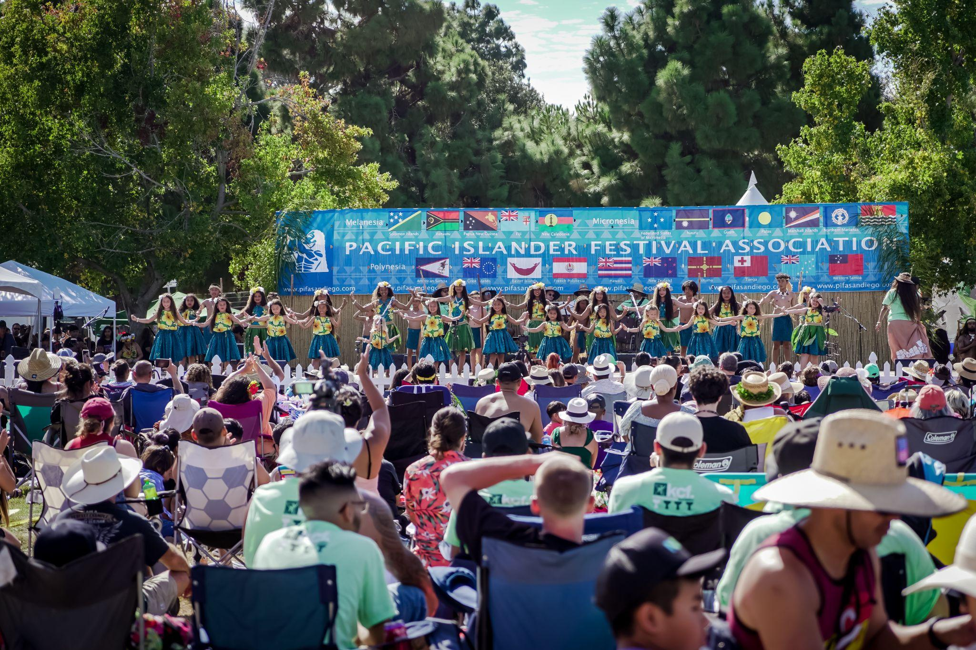
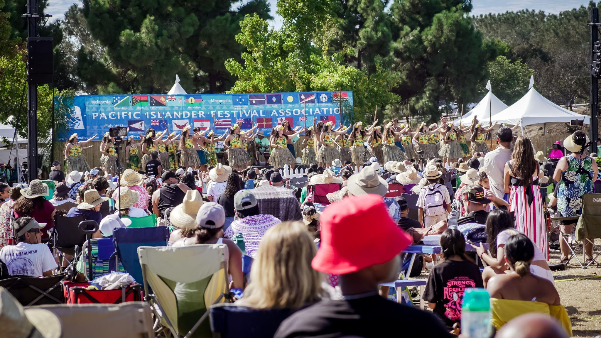
Pacific Islander Festival
Sept 24-25, 2022 San Diego, CA

Slide 20
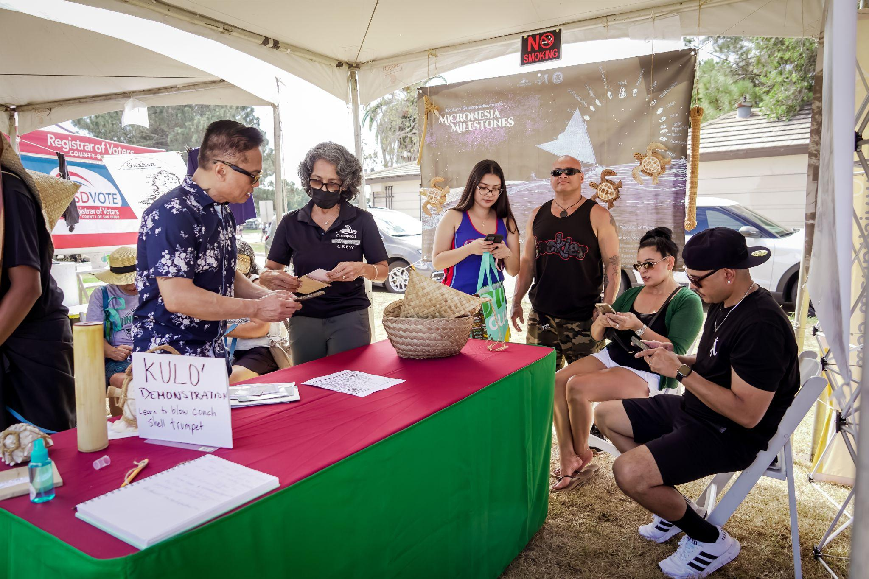
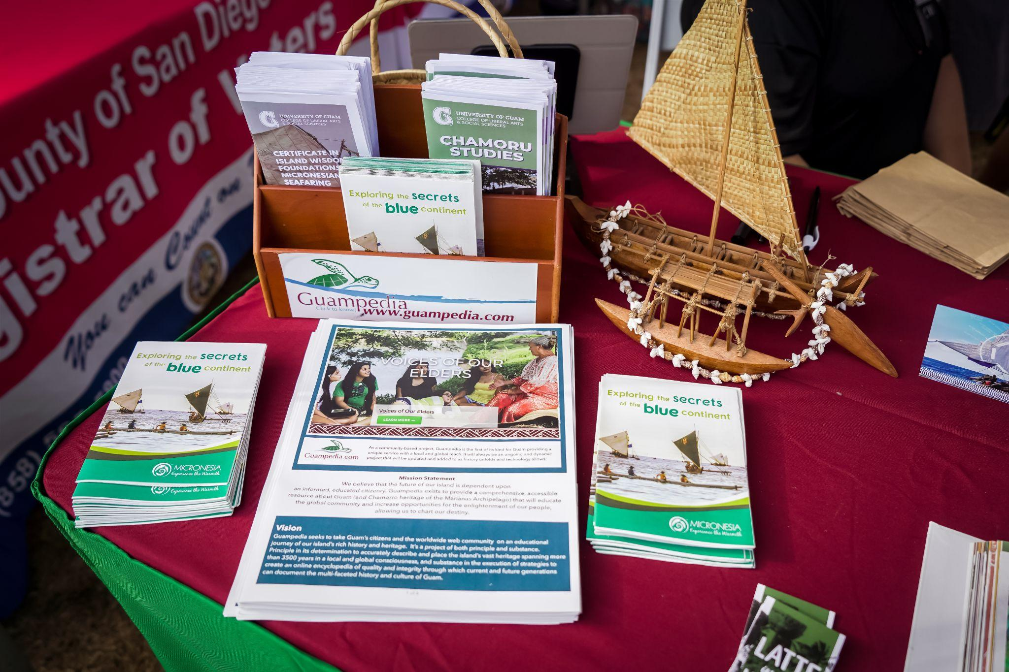
Pacific Islander Festival
Sept 24-25, 2022 San Diego, CA

Slide 21
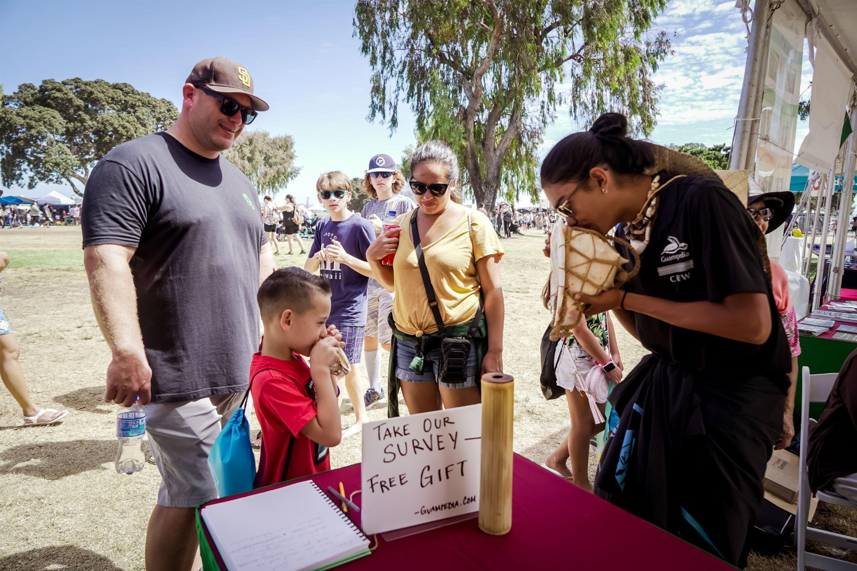
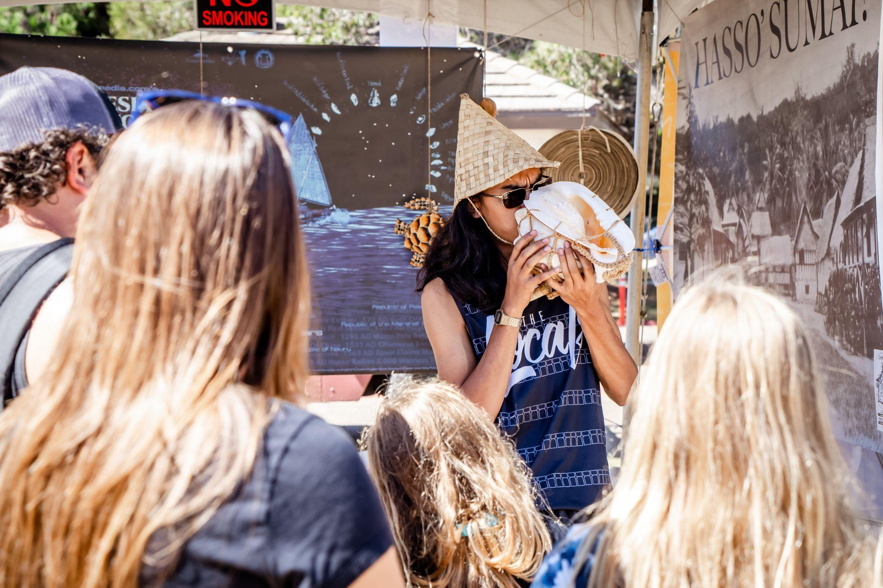
Pacific Islander Festival
Sept 24-25, 2022 San Diego, CA

Slide 22
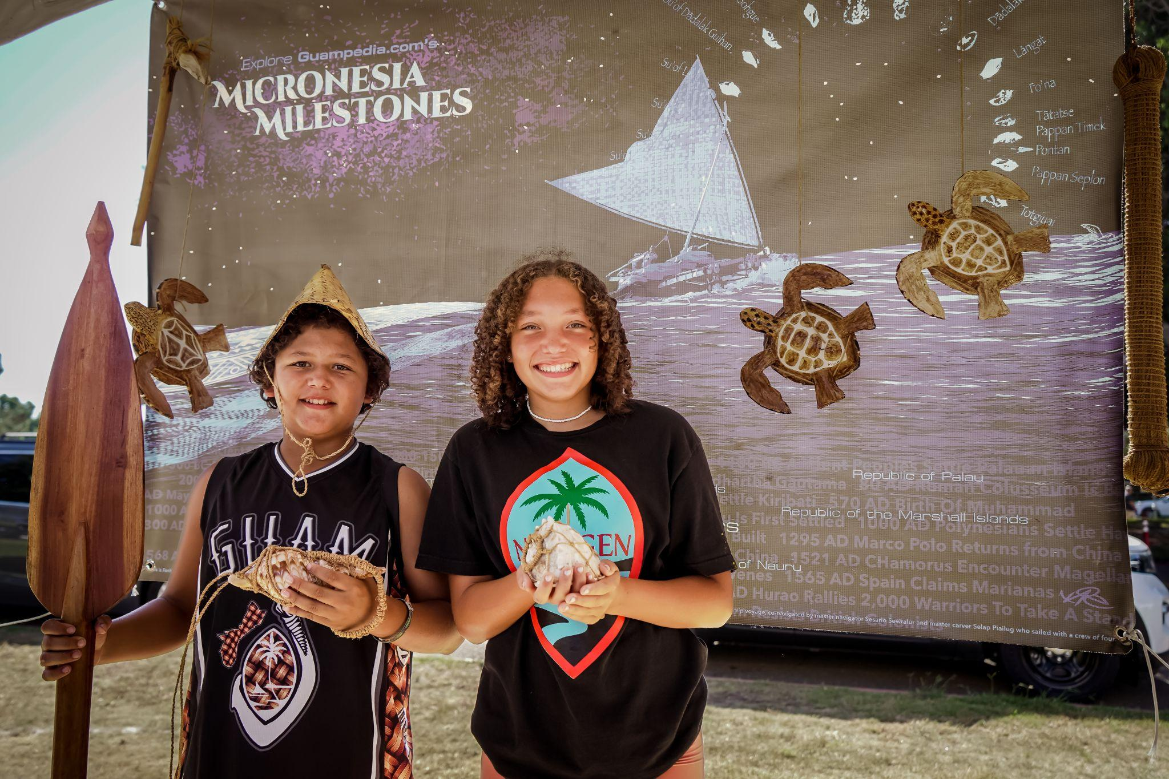
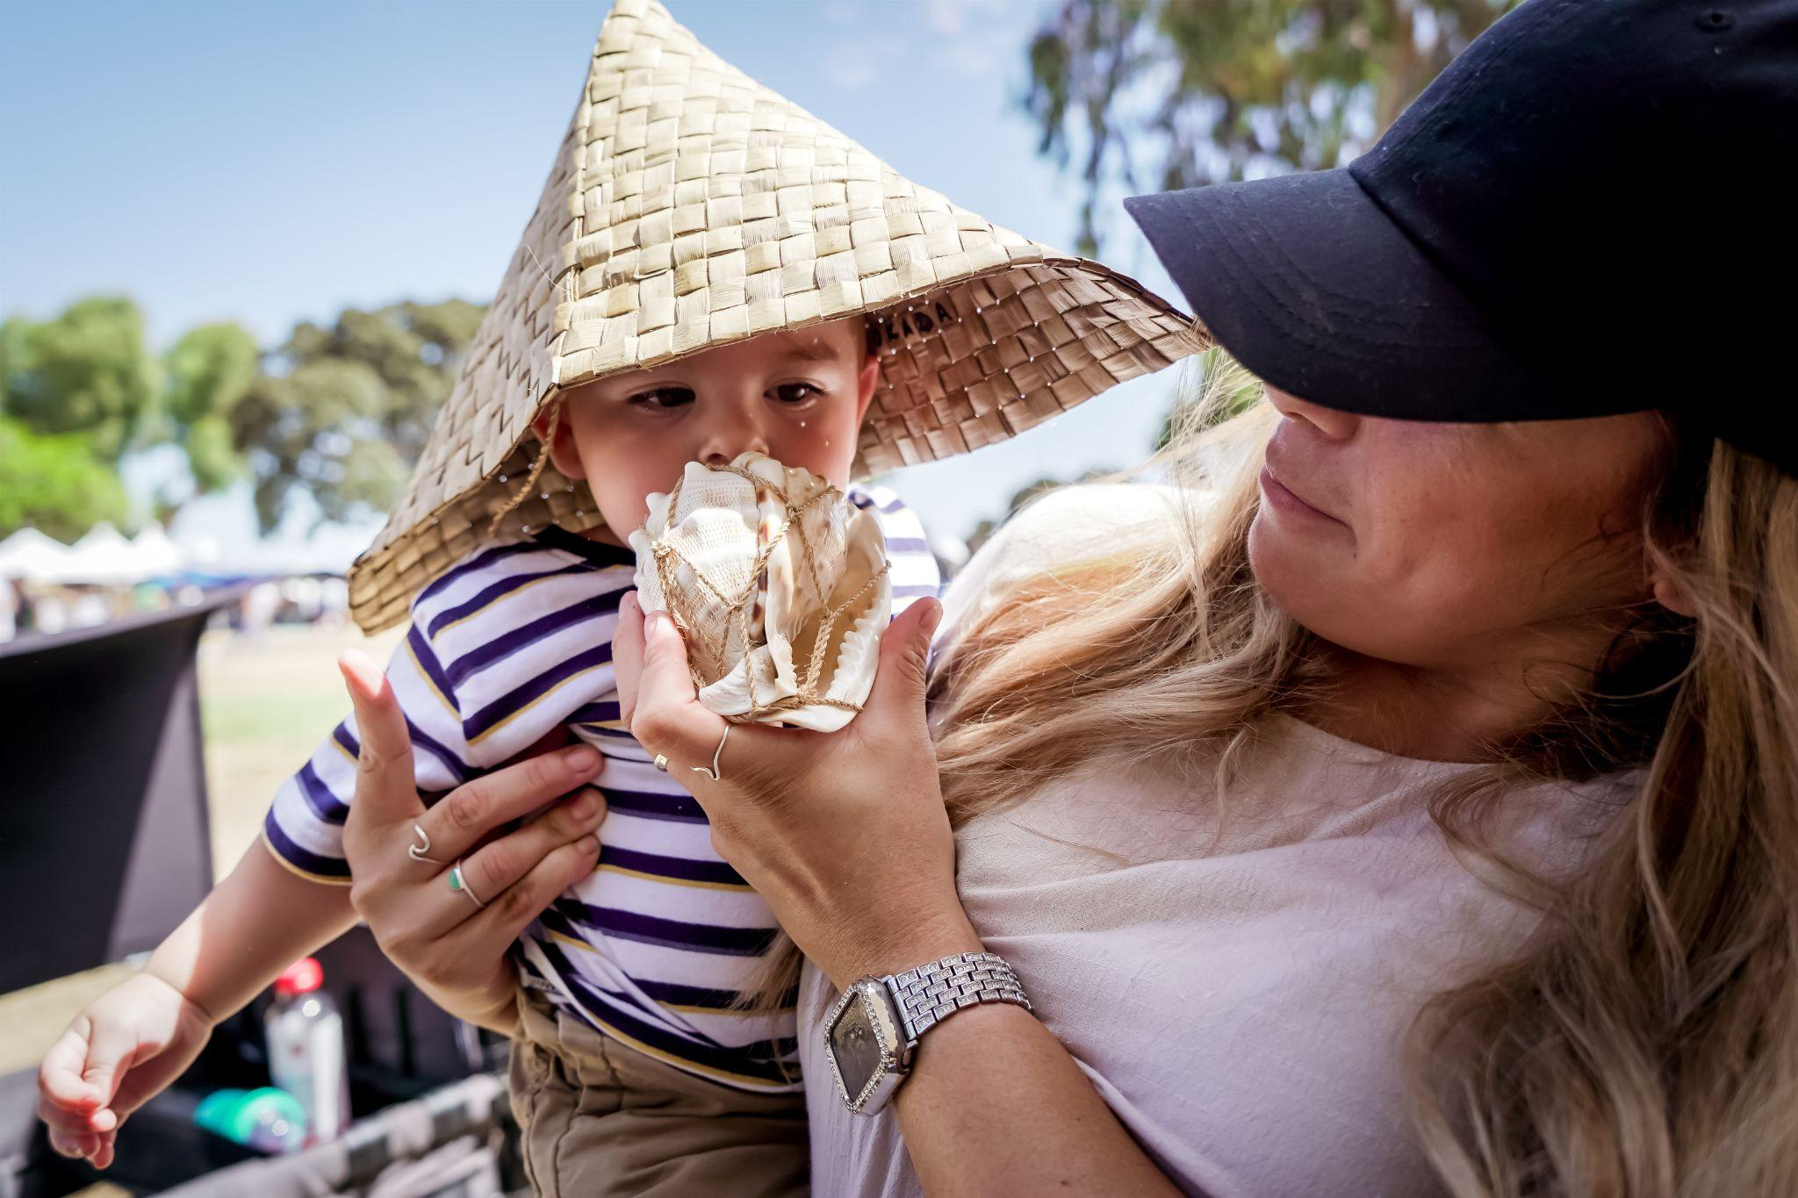
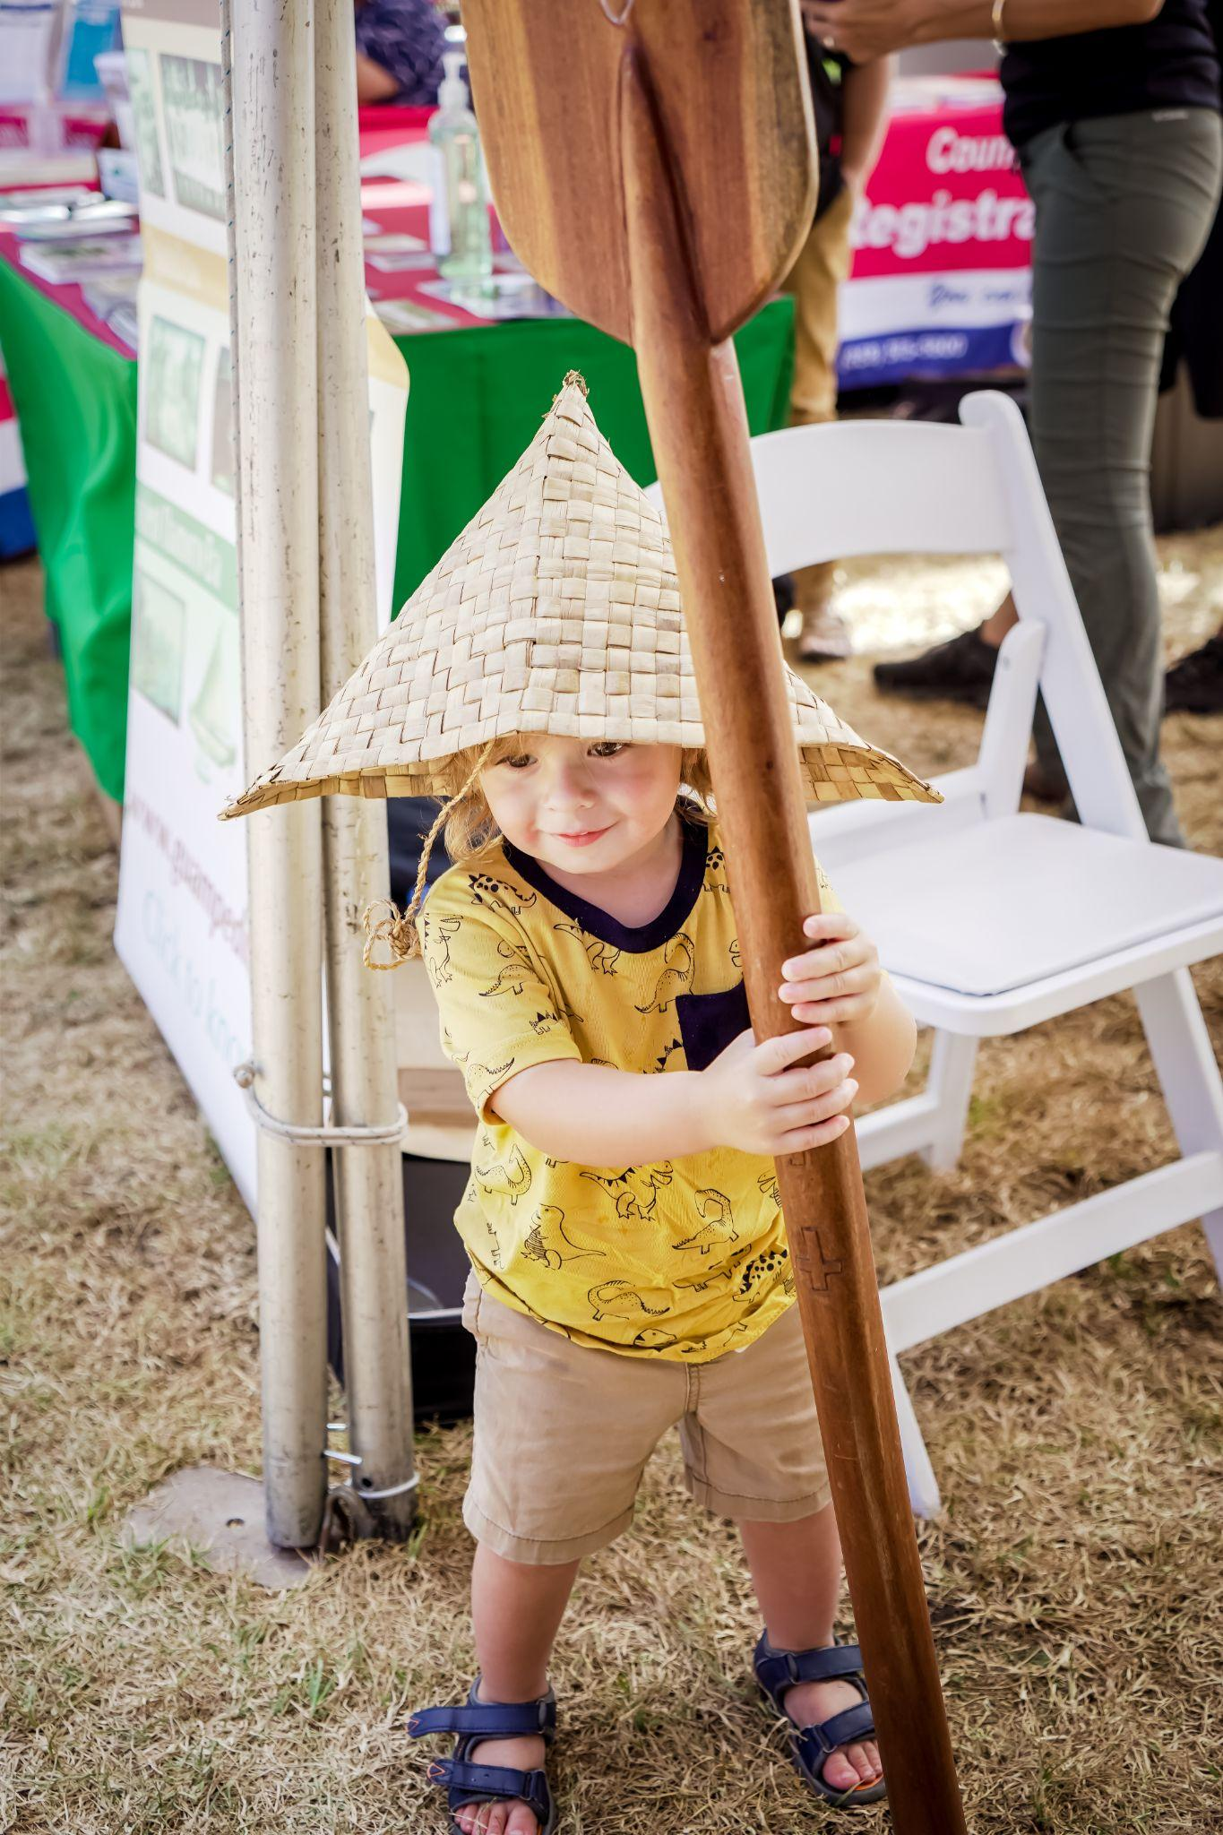
Pacific Islander Festival
Sept 24-25, 2022 San Diego, CA

Slide 23
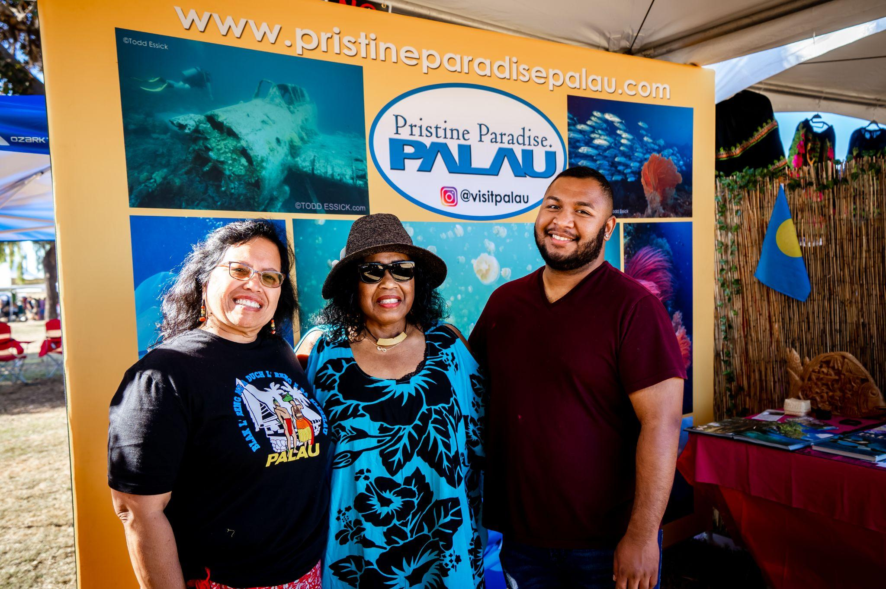
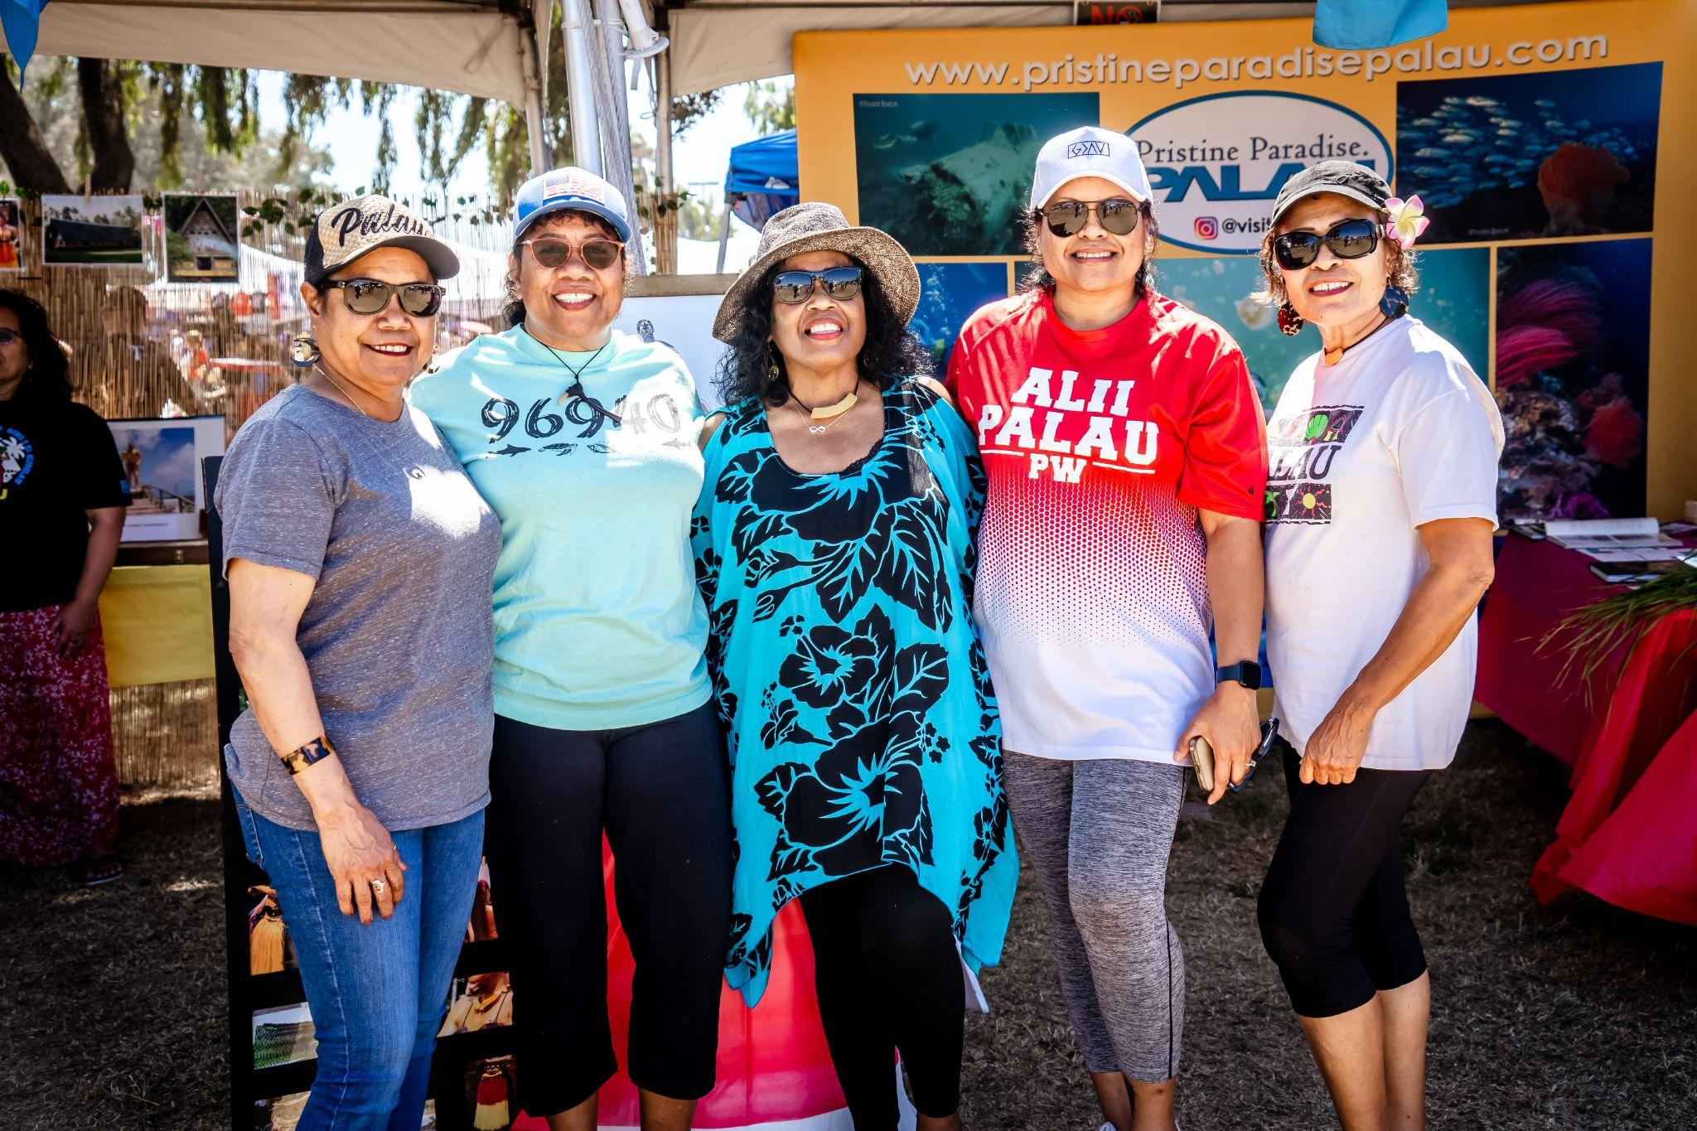
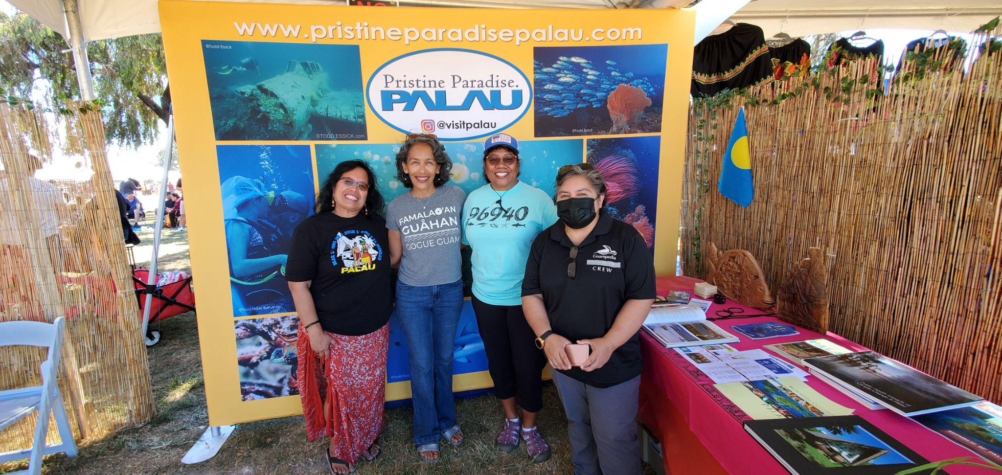
Belau @ Pacific Islander Festival 2022

Slide 24
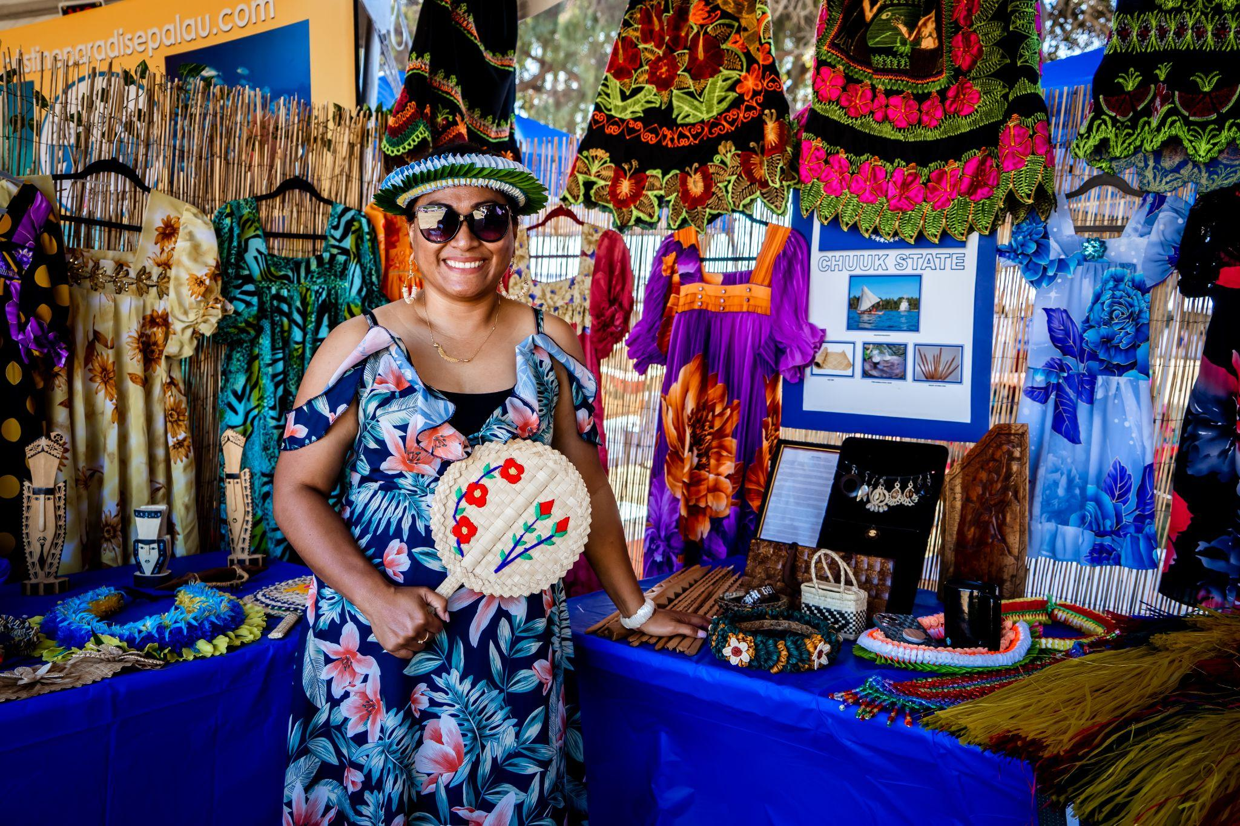
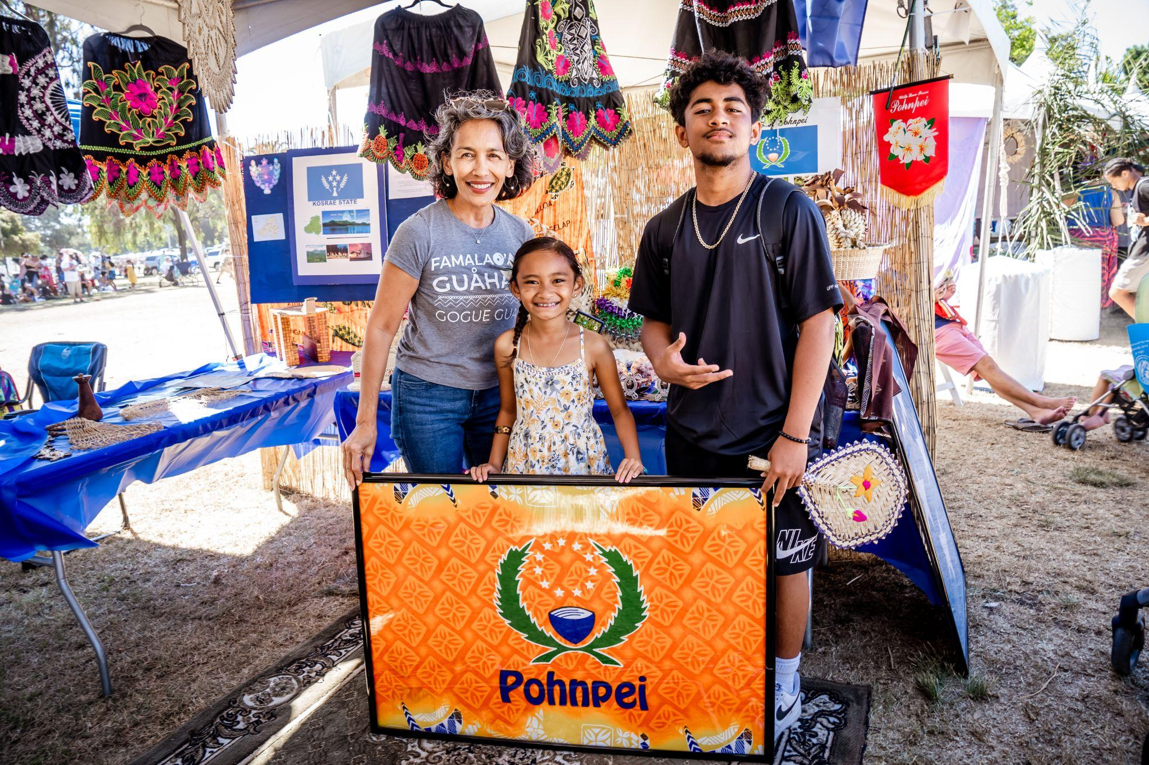
Federated States of MicrONEsia
@ Pacific Islander Festival 2022

Slide 25
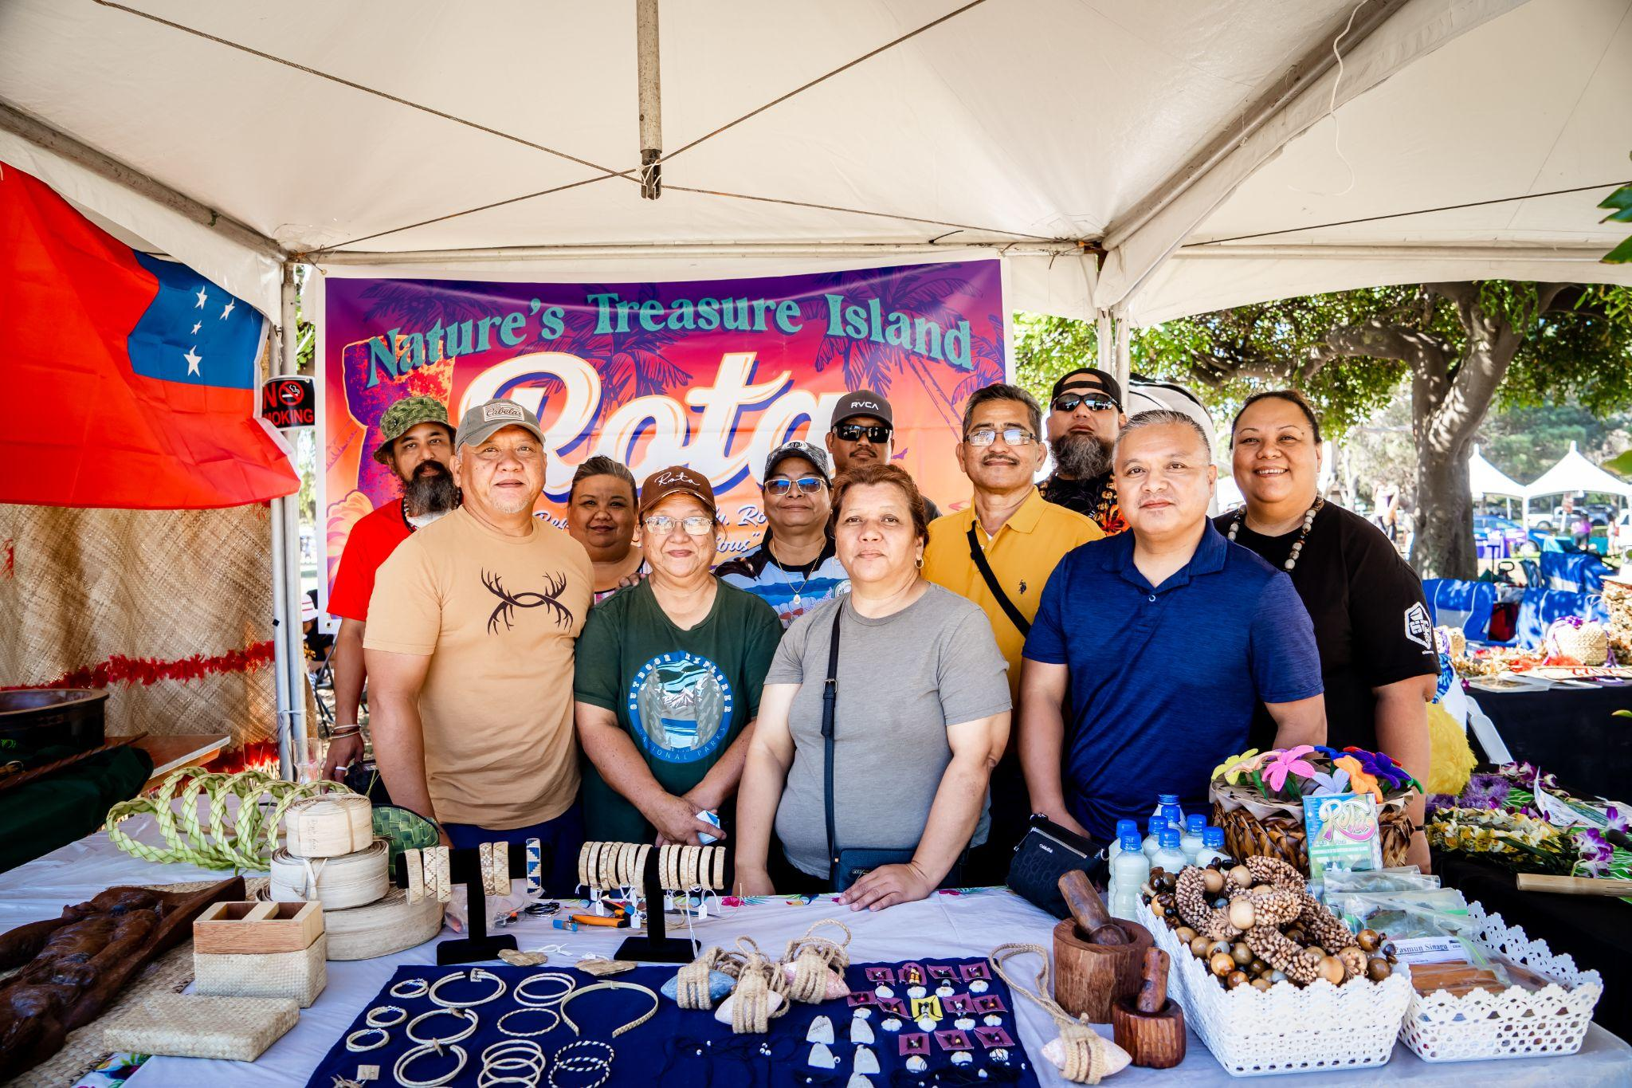
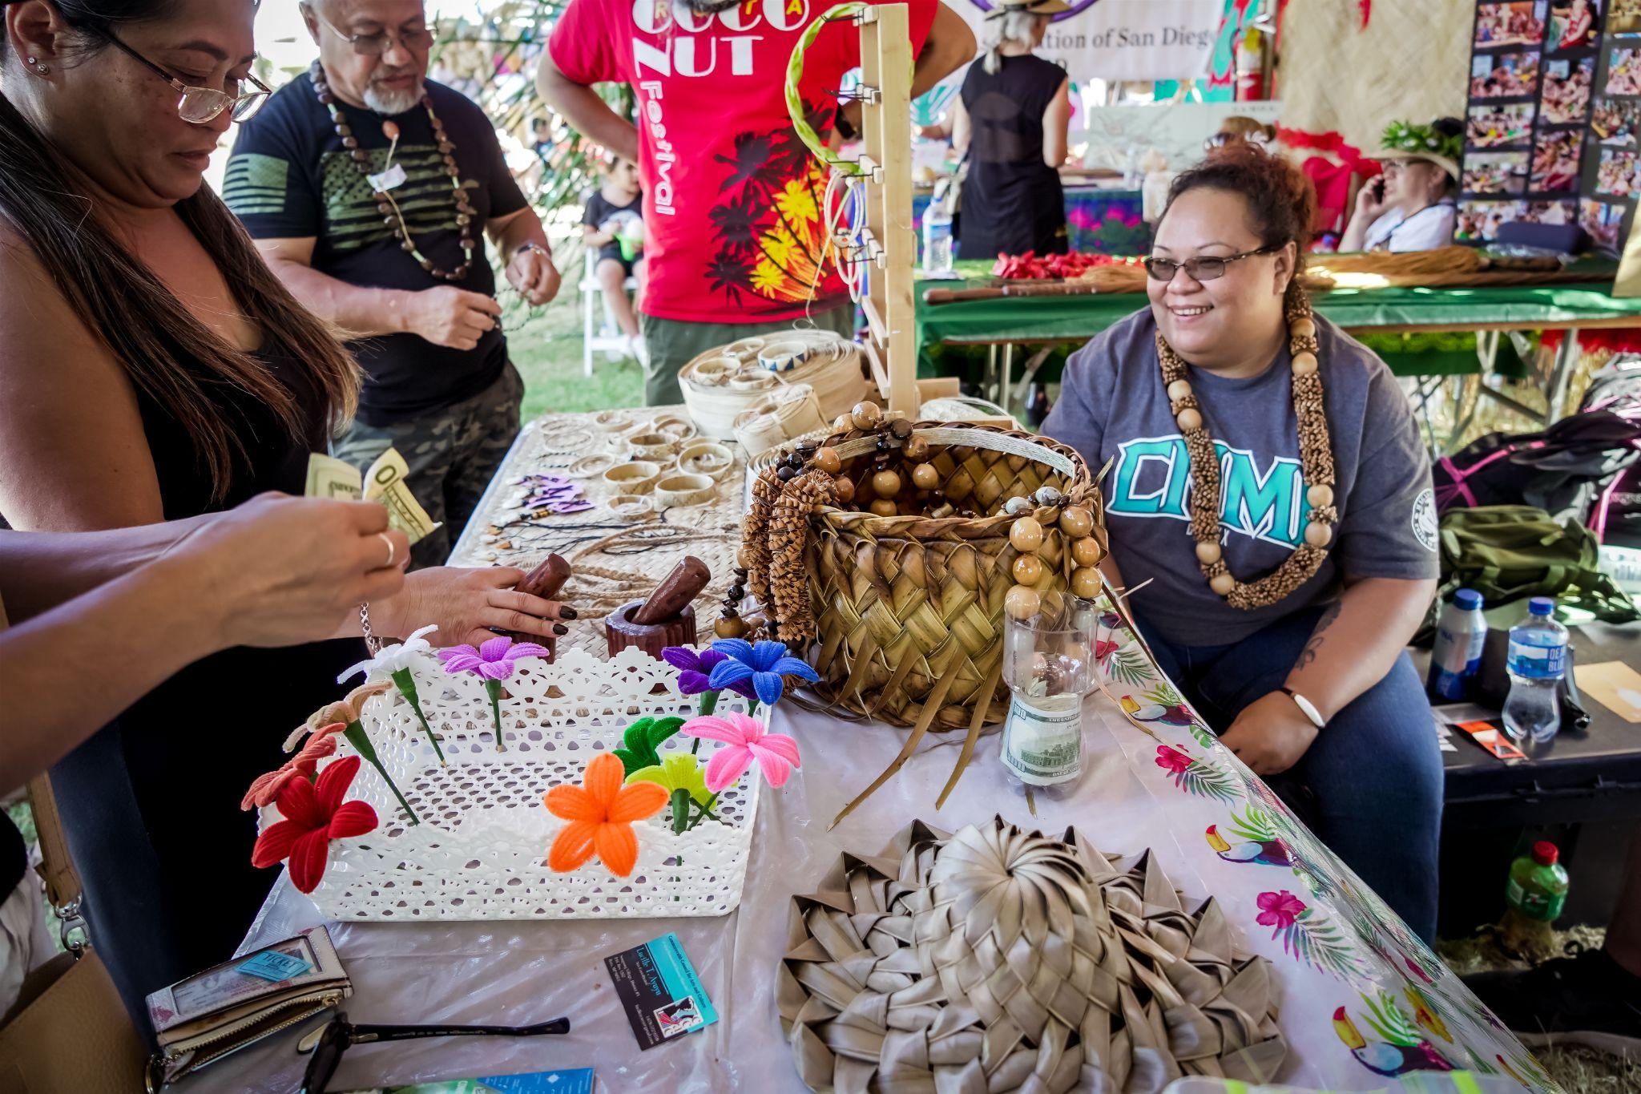
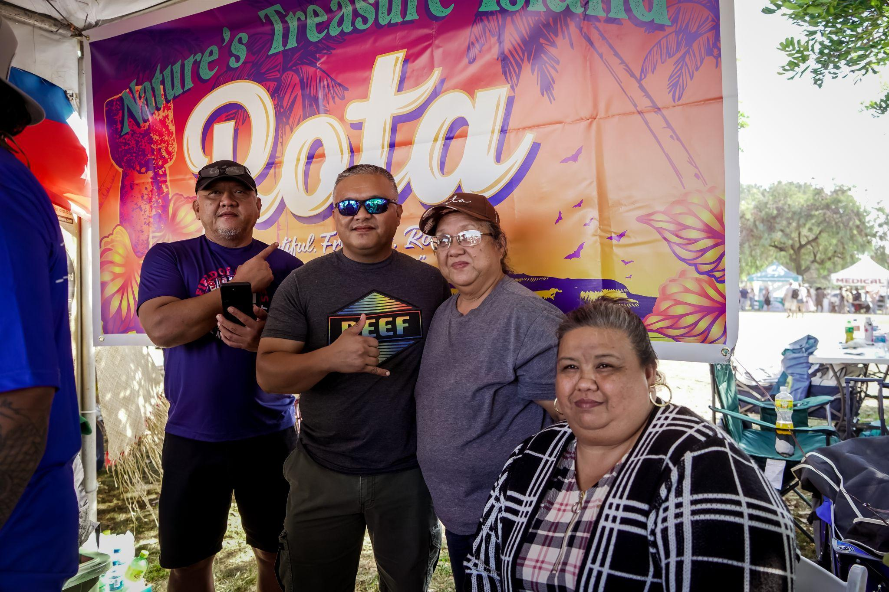
Luta, Northern Mariana Islands
@ Pacific Islander Festival 2022

Slide 26
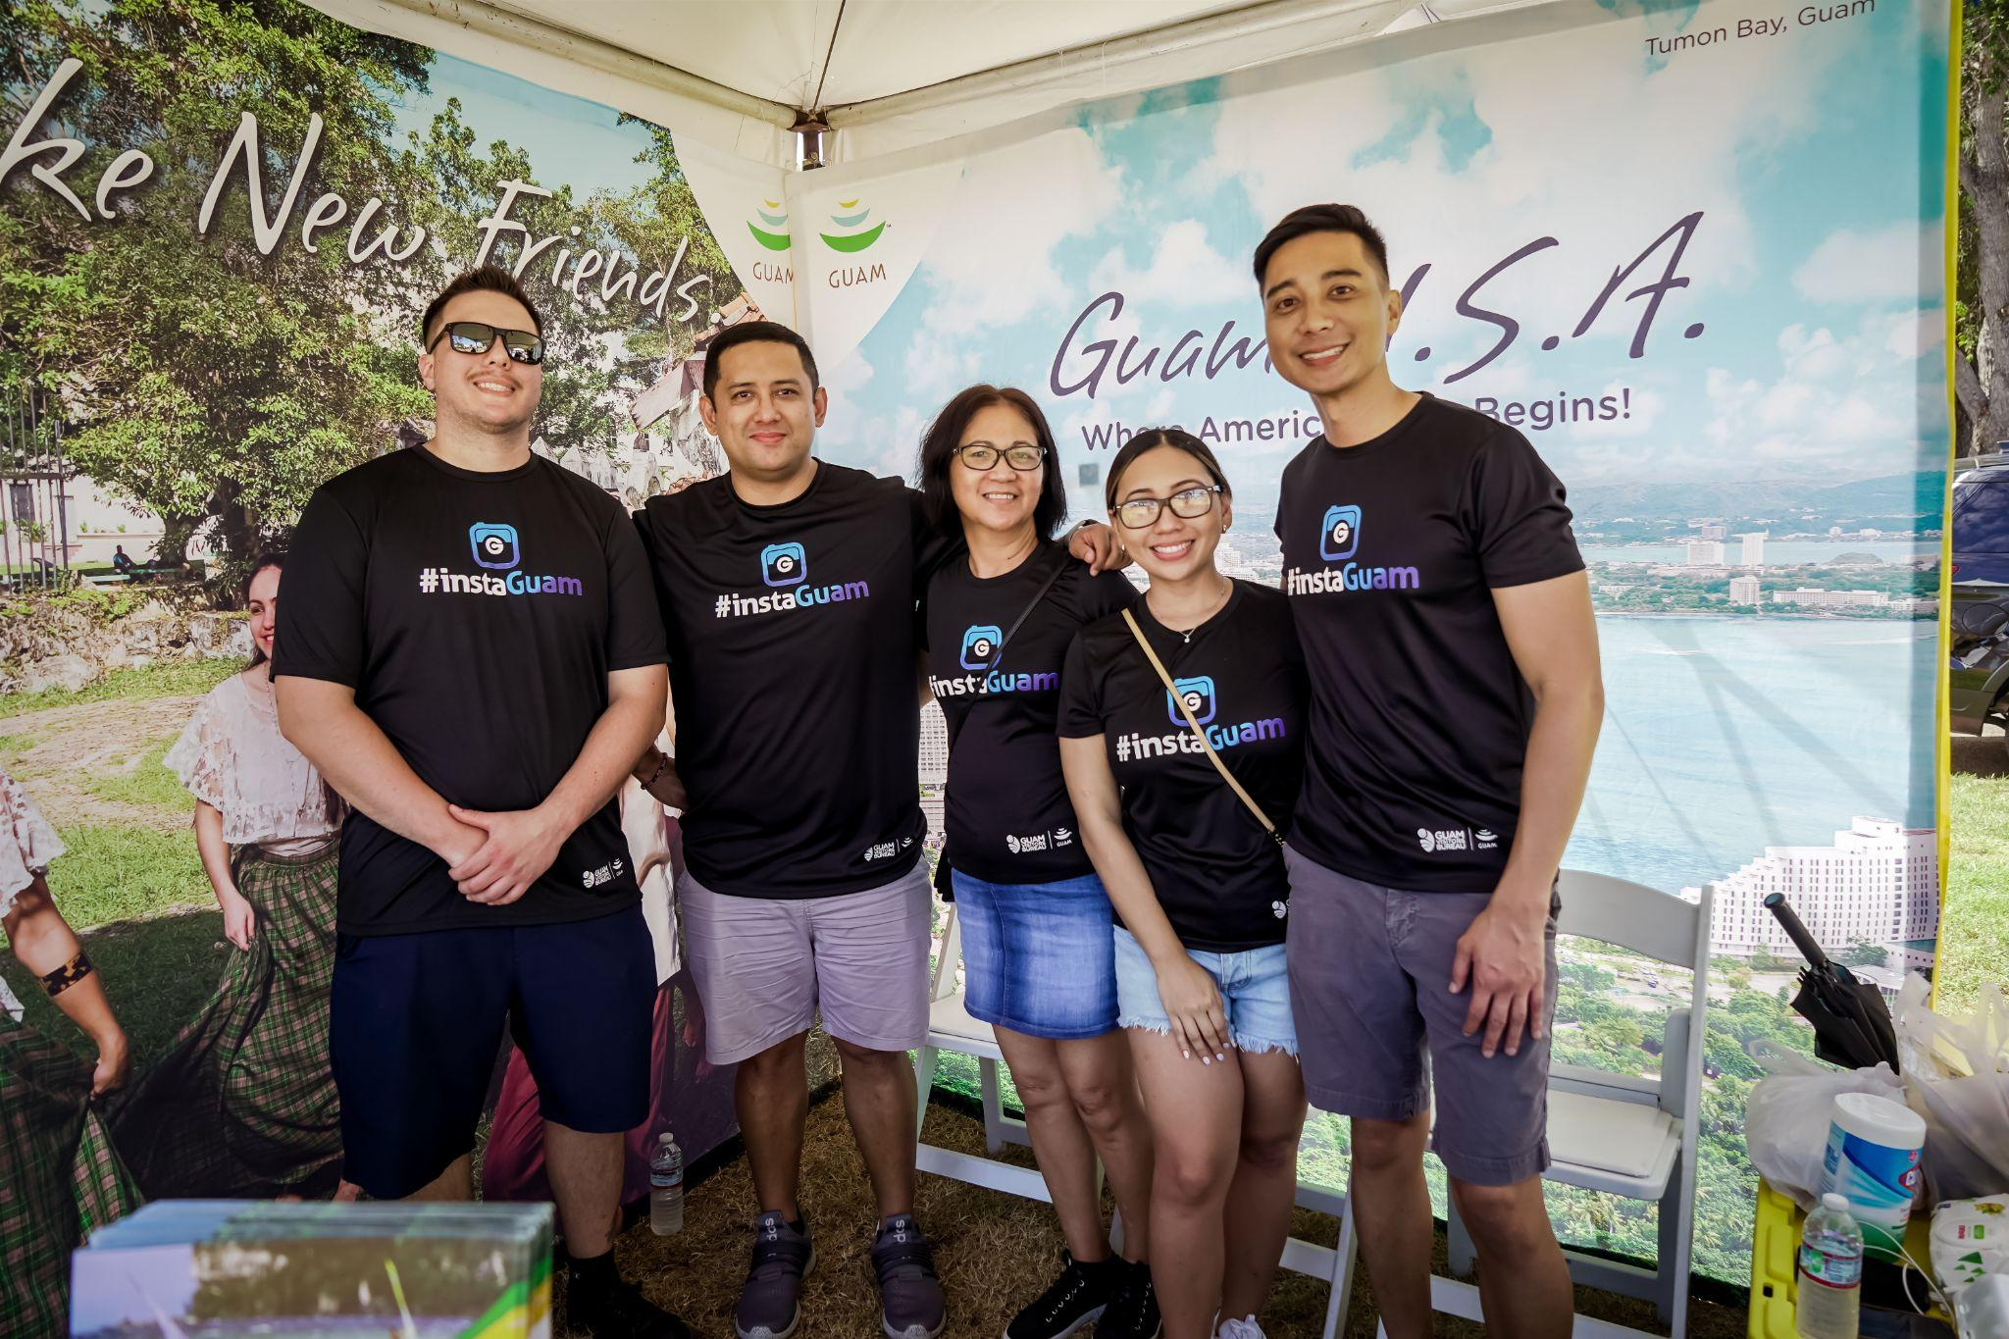
GU Visitors Bureau @ PIFA 2022

Slide 27
2021/2022 VOYAGE TO RECOVERY
PEARLS OF WISDOM SPEAKER SERIES
Oct 15, 2021: “STRATEGIES TO REBUILD TOURISM FOR THE FUTURE IN MICRONESIA: CAPITALIZING ON NEW OPPORTUNITIES” by Fred Schumann, Ph.D. - University of Guam
April 27, 2022: “SUSTAINABLE RESURGENCE IN TOURISM” by David Sanchez, Ph.D. - University of Pittsburgh

Slide 28
Support Regional Cultural Producers
Heritage Gift Shop upgrade in process
Outreach & promotion - 900+ subscribers to Monthly E-newsletter; 3217- Instagram; 6236 - Facebook
Guampedia manages product presentation, promotions, & sales transactions
Cultural Producers dedicate and manage their inventory, packaging and shipping
Contact: guampedia.rpn@gmail.com

Slide 29
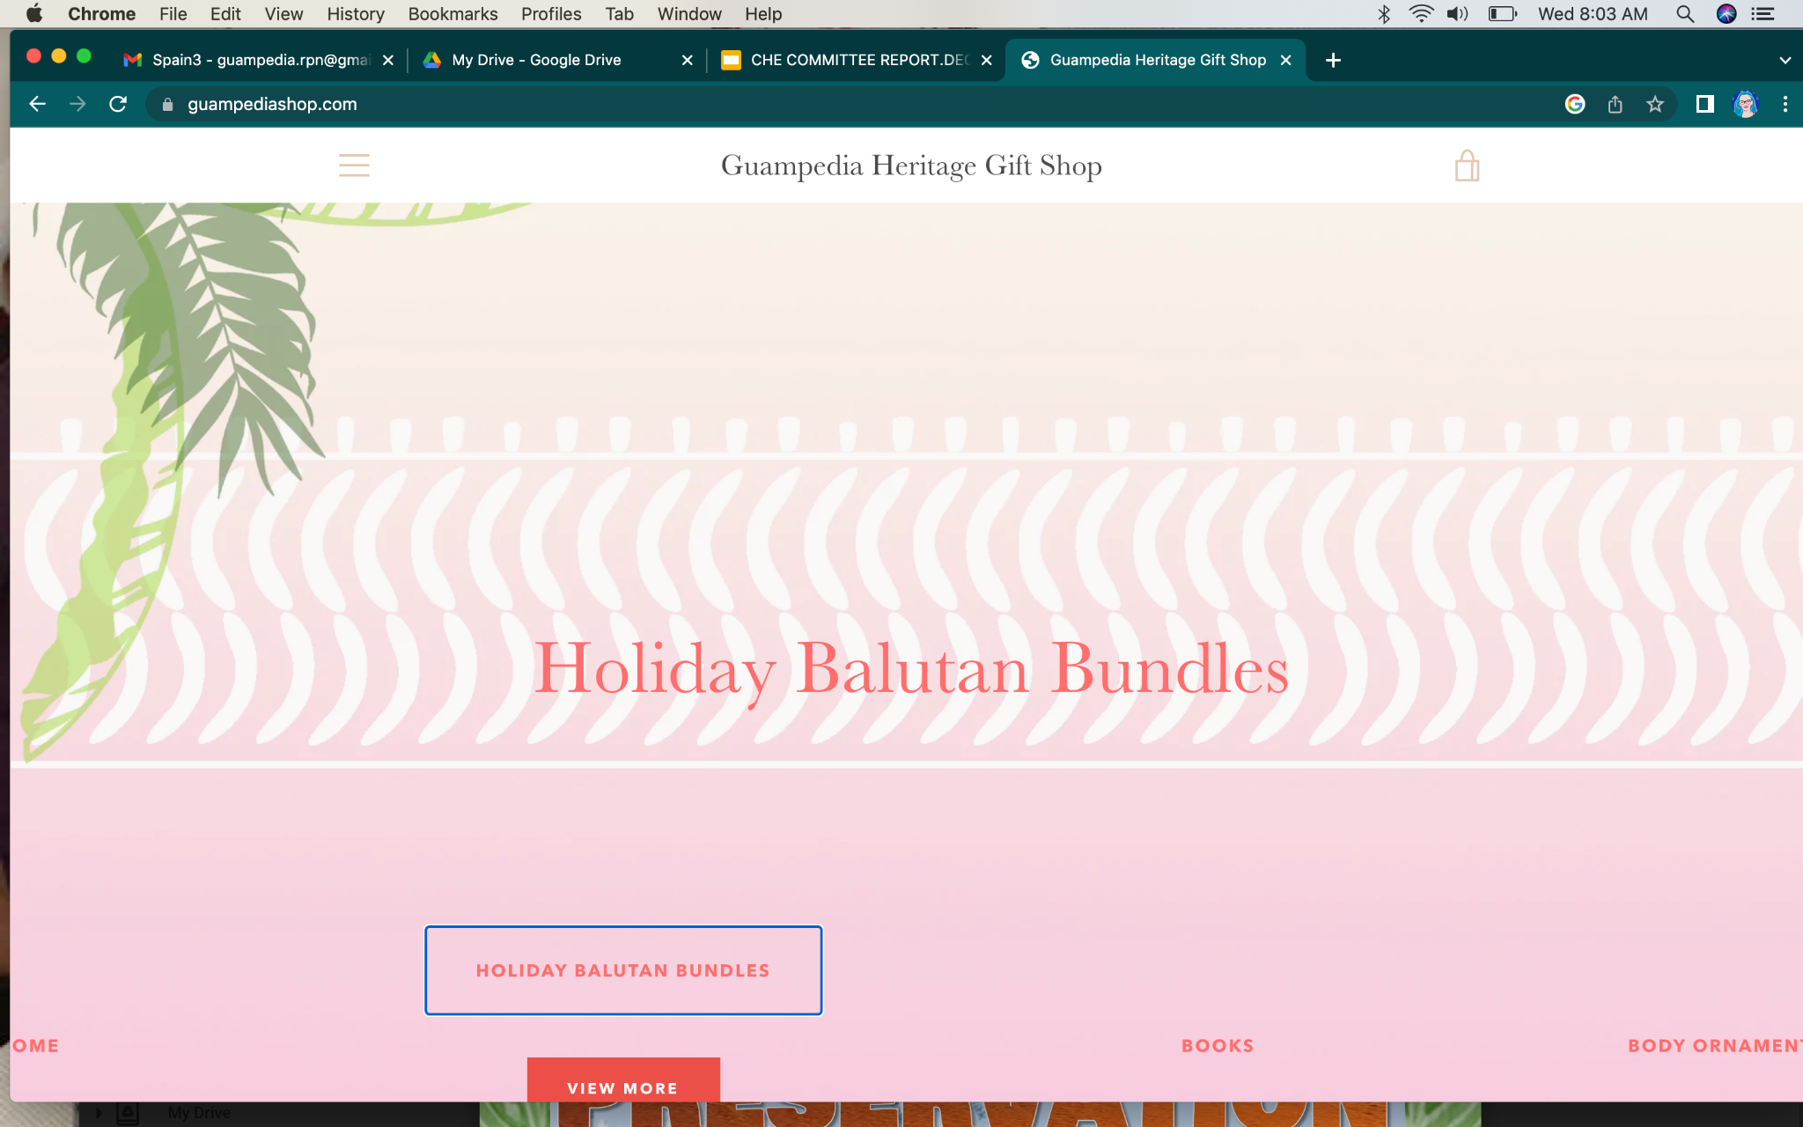
Guampedia: Online Heritage Gift Shop
nonprofit educational website
average 30K visitors per month
social enterprise - 9 years
Culture of Connecting Grant Project: Promote regional cultural producers - assist with photography, profile & shipping

Slide 30
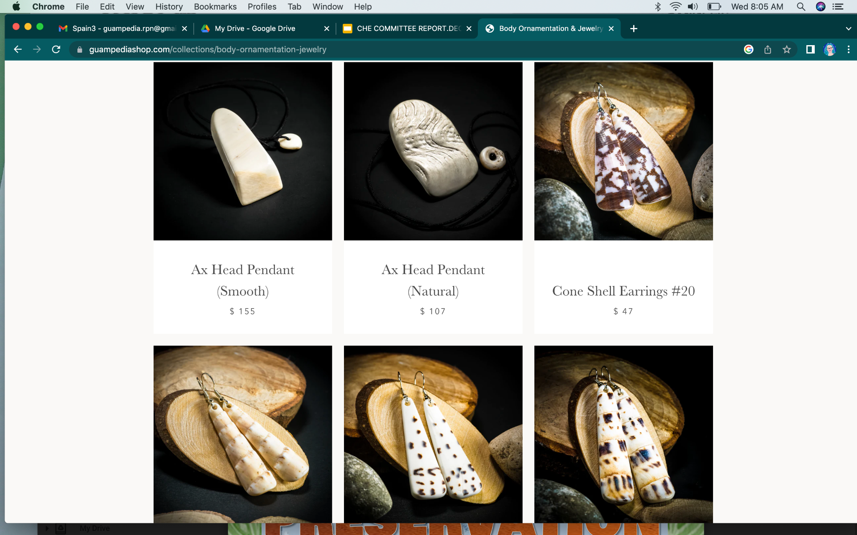
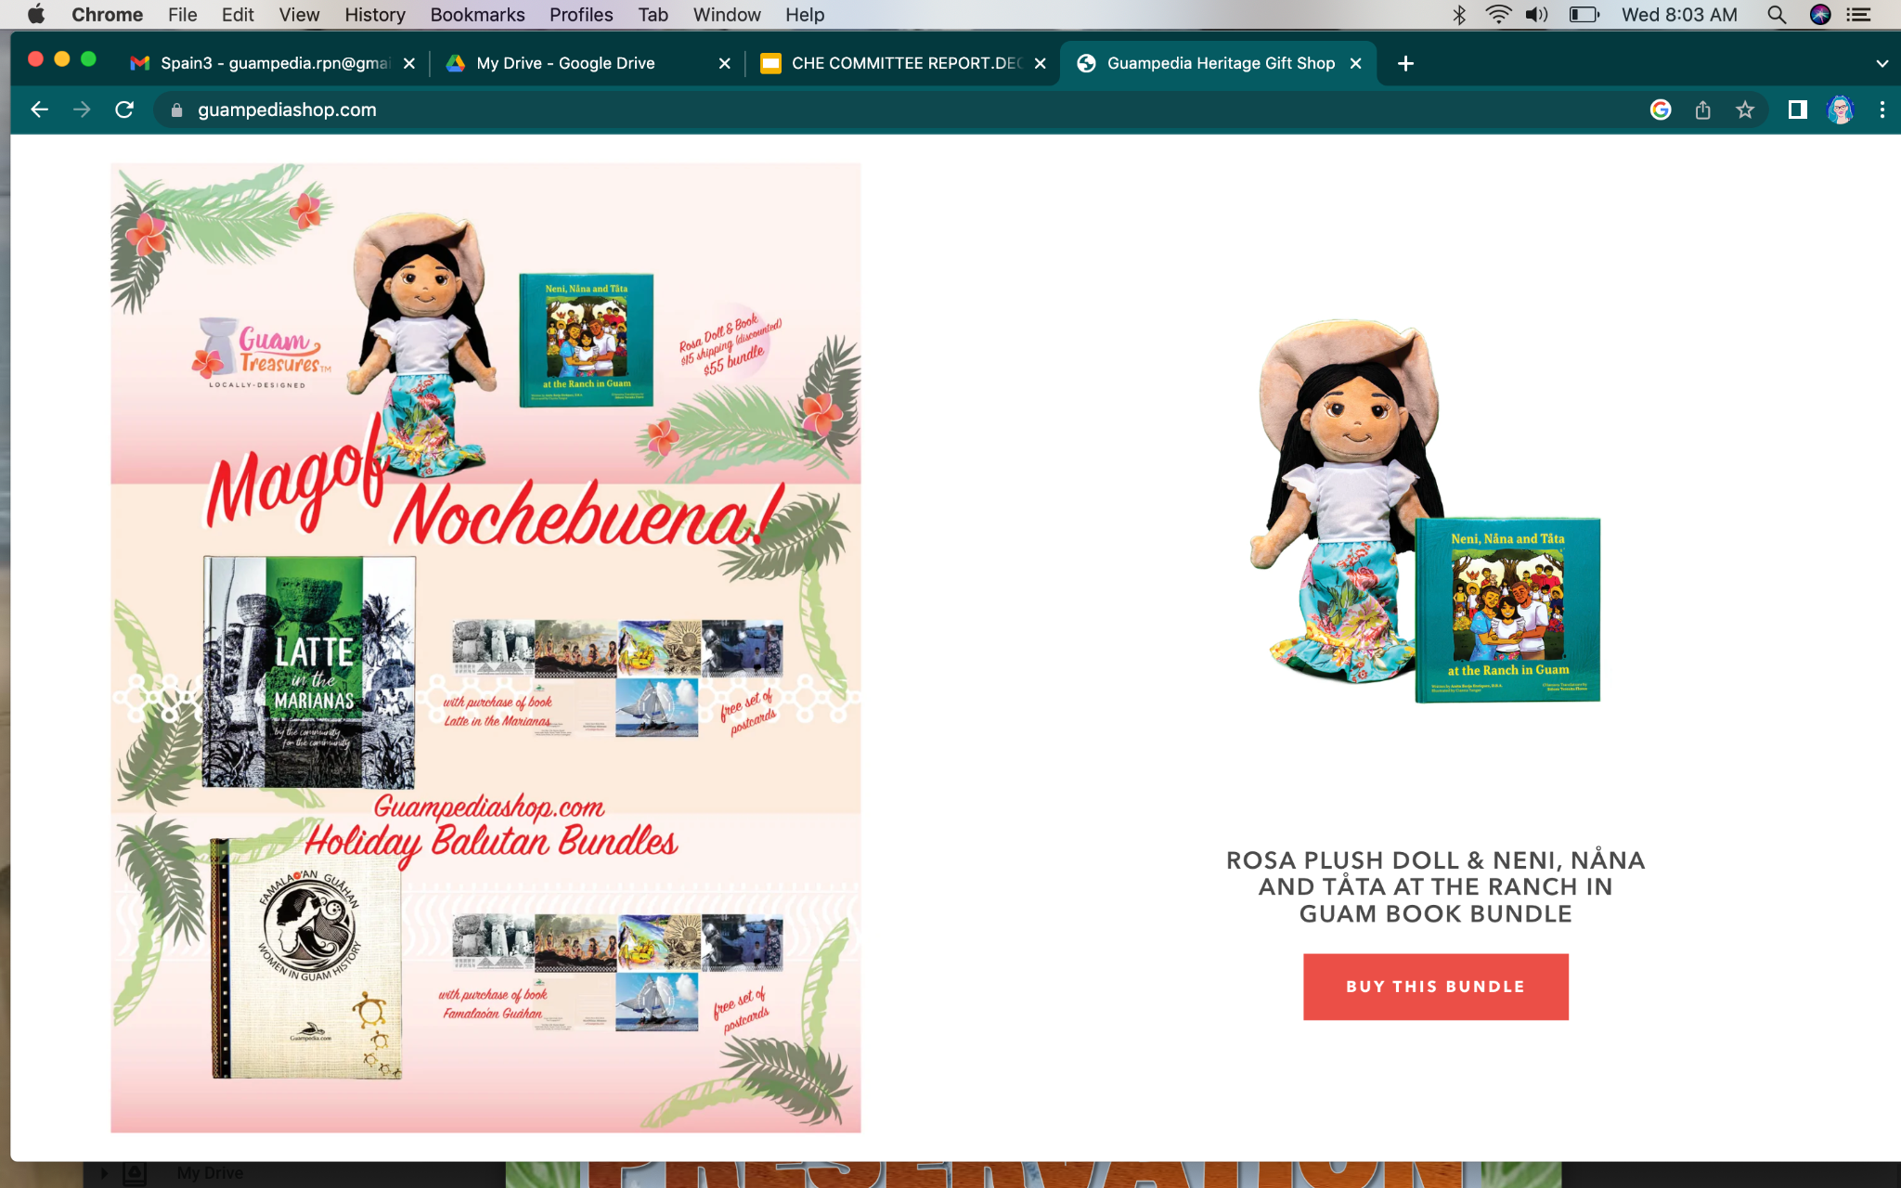
Guampedia: Online Heritage Gift Shop

Slide 31
MicrONEsia is rooted in 4000 years
of cultural heritage. Our indigenous knowledge & island wisdom have been sustaining and connecting our island communities, through natural disasters, colonization, war and pandemics.

Slide 32
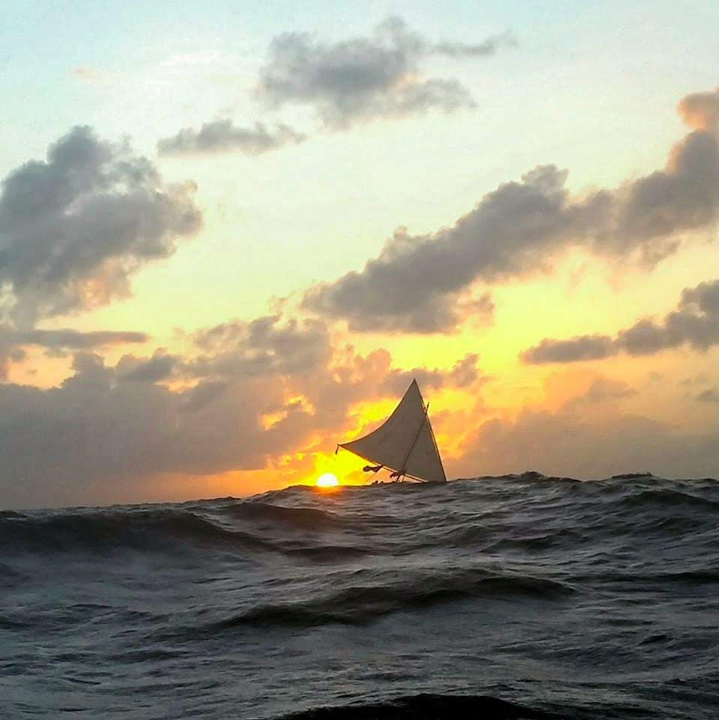
MicrONEsia: Voyaging for 4000 Years
Educational Outreach
Traditional Seafaring is a way of life in MicrONEsia; It’s a life line that connects us all! It’s a way of knowing, a way of doing...
Culture of Connecting Grant Project Educational Outreach:
Produce MicrONEsia Digital Series
2023 Promotions - Flame Tree Festival (Saipan), Chamorro Festival (Calif), Pacific Islander Festival (Calif)

Slide 33
Cultural Heritage & Environment Committee
Charting Our Course…2023
MicrONEsia Educational Outreach Collaborations:
Digital Series - MicrONEsia: Voyaging for 4000 Years - Our Navigational Elders / Travel Exhibition - FESTPAC 2024
MicrONEsia’s Origin Stories - Compilation of Indigenous Origin Stories - Poster series & for online access & social media promo
UOG Island Wisdom - Convening MicrONEsia’s Grand Master Navigators - Charting the Course for Traditional Seafaring
Continue support & collaboration with Education, Marketing & PR Committees

Slide 34
Culture, Heritage & Environment
Committee Members
Anne Perez Gena Rojas
Fred Schumann
Palau Visitors Authority
Please Join Us!

