Slide 1
MARKETING COMMITTEE REPORT

Slide 2
Micronesia Pavilion Opportunities
Asia Dive Expo Ocean Mission 2023
March 31 – April 2, 2023
PATA Travel Mart 2023
Date and Venue TBC
DEMA Show 2023
November 14 – 17, 2023, New Orleans, LA

Slide 3
Regional Events
Quality of Life Expo 2023
Organized by the Joint Region Marianas
Expo aims to build new partnerships, strengthen existing community relationships, and enhance the quality of life for service members and their families.
February 22, 2023; 1 – 5PM at the Westin Resort Guam
Guam Micronesia Island Fair 2023
GVB plans to bring back the GMIF some time next year in 2023.
GMIF will be in a smaller scale compared to previous years. More details will be shared once available.

Slide 4
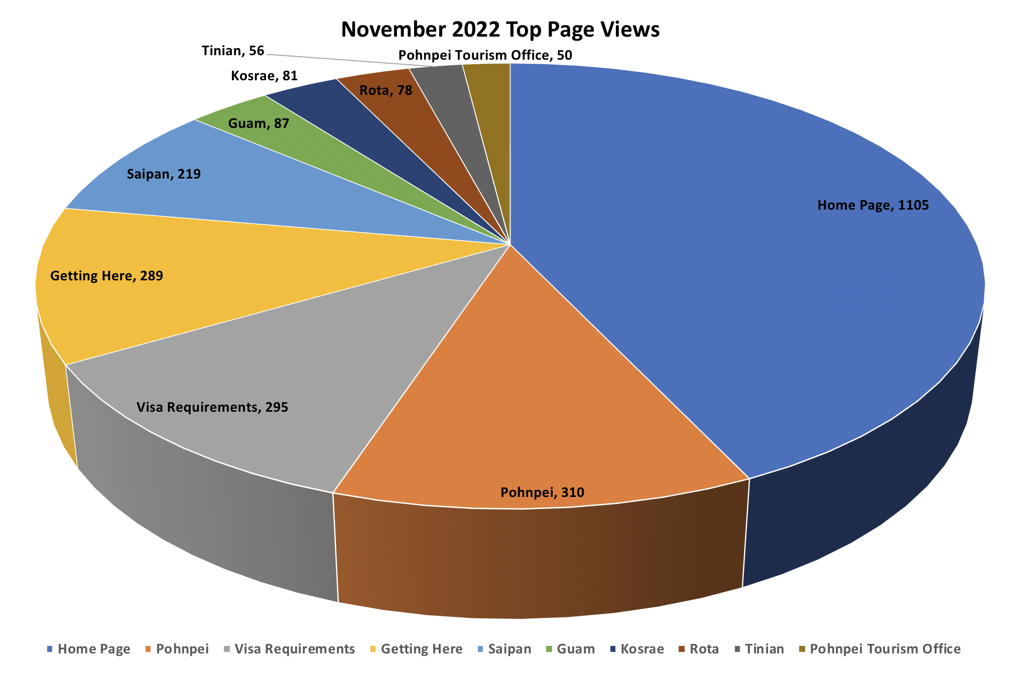
MicronesiaTour.com

Slide 5
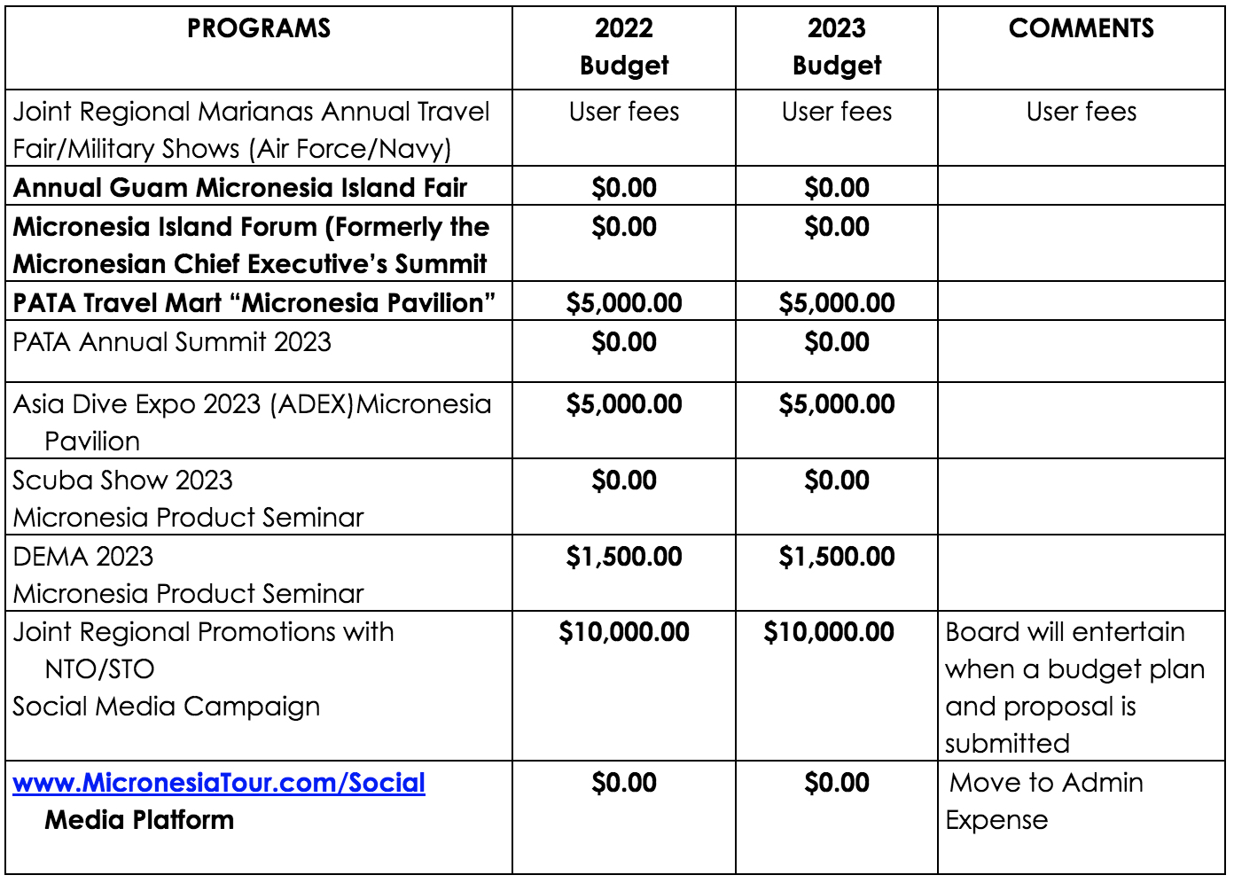
FY2023 Budget Request

