Slide 1
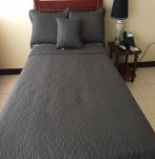
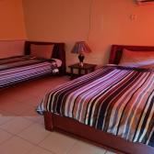
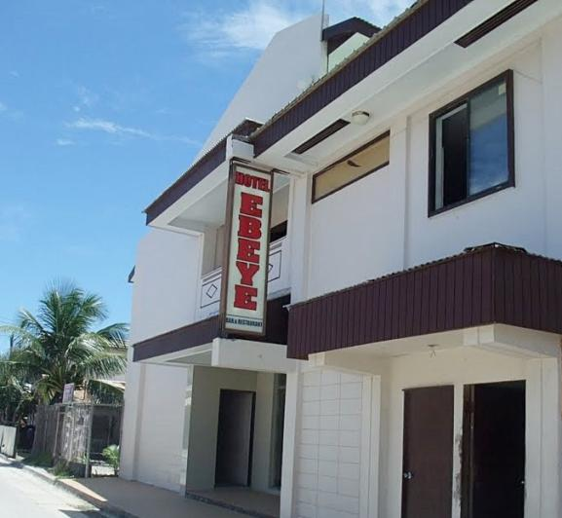
Hotel Ebeye

Slide 2
About Us
Hotel Ebeye is located on the island of Ebeye within the Kwajalein Atoll, Republic of the Marshall Islands.
The hotel, which is managed by Majuro’s Marshall Islands Resort, has 18 rooms, made up of two suites, two deluxe rooms, fourteen double rooms.
Contact Information
Hotel Ebeye
PO BOX 5460
Ebeye Marshall Islands 96970
Phone: (692) 329-5230
Email: hotelebeye.rsvn@gmail.com
Front Desk Manager: Joseph Bulles
Email: JOClicious@gmail.com
Phone: (692) 235-3229

Slide 3
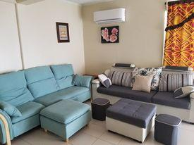
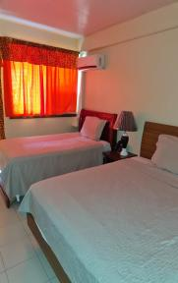
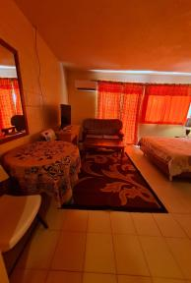
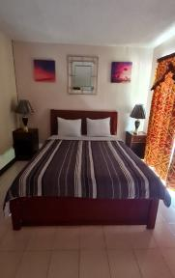
GUESTROOMS & RATES
Regular Room
Now
$77.60/per night
(tax inclusive)
Deluxe Room
Now
$99.20/per night
(tax inclusive)
Suite Room
Now
$153.20/per night
(tax inclusive)

Slide 4
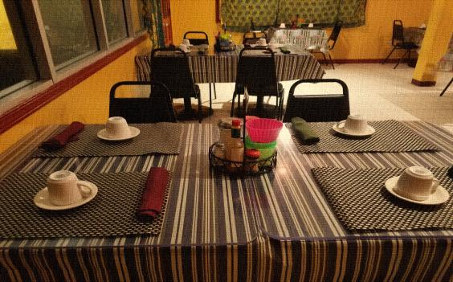
RESTAURANT
Our very own restaurant serves various cuisines, mostly American, Filipino and Marshallese local food. It is open for breakfast, lunch and dinner
RESTAURANT BUSINESS HOURS
MONDAY – SUNDAY
7:30am-9:00am (Breakfast)
11:30am-2:30am (Lunch)
5:30pm-9:00pm (Dinner)

Slide 5
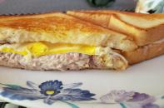
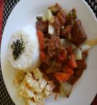
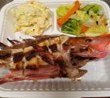
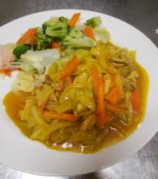
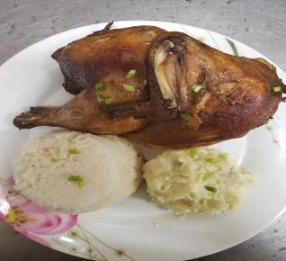
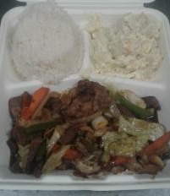
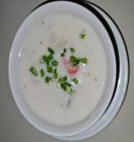
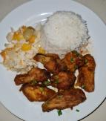
FEW OF OUR MENU SELECTIONS
GRILLED TUNA & CHEESE
BEEF STEW
GRILLED REEF FISH
CHICKEN CURRY
OVEN BAKED CHICKEN
CHOPSTEAK
SEAFOOD CHOWDER
HOT WINGS

Slide 6
COVID-19 RESPONSE & PREPAREDNESS PLAN
The following were implemented in response to COVID-19.
Employee COVID-19 Awareness Training. Employees were educated about the virus, and were trained on various preventive measures and the importance of exercising the measures consistently.
Staff COVID-19 Vaccination. Feb 2021 all were vaccinated.
Rigorous Sanitization & Hygiene Training and Practice.
Update Marketing Strategies & Process Improvements.
Engaged with customers more to keep them informed about our plans and response.
In preparation for border opening, we continue with the following:
Consistently implement COVID-19 preventive measures.
Consistly take refresher trainings on Sanitization & Hygiene
Continue with process improvement initiatives including customer service
Upgrade guestrooms & the restaurant.
.

