Slide 1

Yap Visitors Bureau Report

Slide 2

Local/Regional Events (2022-
2023)
December 19-23
Christmas Night Market
January 27, 2023
Island Market at the Yap Living History
Museum
February 2023- EXPO in Kosrae

Slide 3
Overseas Events (2022-2023)
Boot Show in Düsseldorf-January 2023

Slide 4
Announcements
Board Members of YVB
• Lee Weeber – Chairman
• Jerry Beaty –Vice Chairman
• Hanspeter Gsell-Secretary
• Bill Acker-Treasurer
• Lubuw Falanruw-Member
• Anthony C Tareg-Member

Slide 5
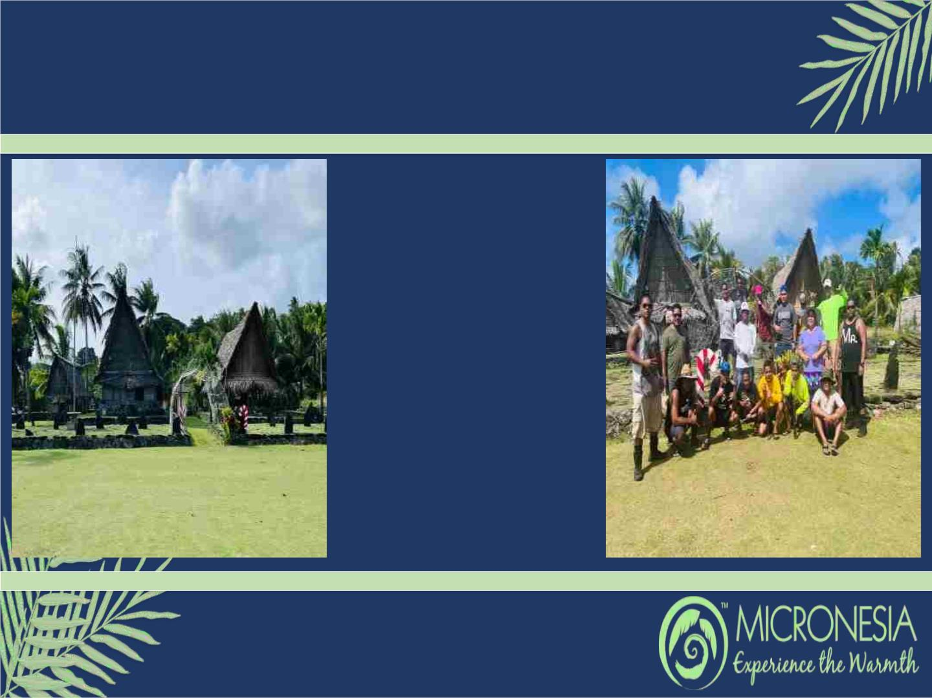
Christmas in Yap
Because it's that time of the year
where family, friends and
communities gather to celebrate
the Holidays, Yap Visitors
Bureau will once again spark up
the Yap History Museum, a
central piece of bliss in Colonia
town, for the island's holiday
cheer. Leo's Crew, Bank of
Guam-Yap Branch, FSM
Development Bank-Yap Branch,
Yap's Division of Public Safety,
Mr. Yang Gang, schools, local
vendors and private businesses
and the communities help with
decorations every year... This
year, the FMI (Fisheries Maritime
Institution) has volunteered to
assist with the preparations and
decorations. Lights will be turned
on December 19th-23rd starting
at 6pm. Because it's in Yap, Yap
wishes everyone a Merry
Christmas and Happy New Year!

Slide 6
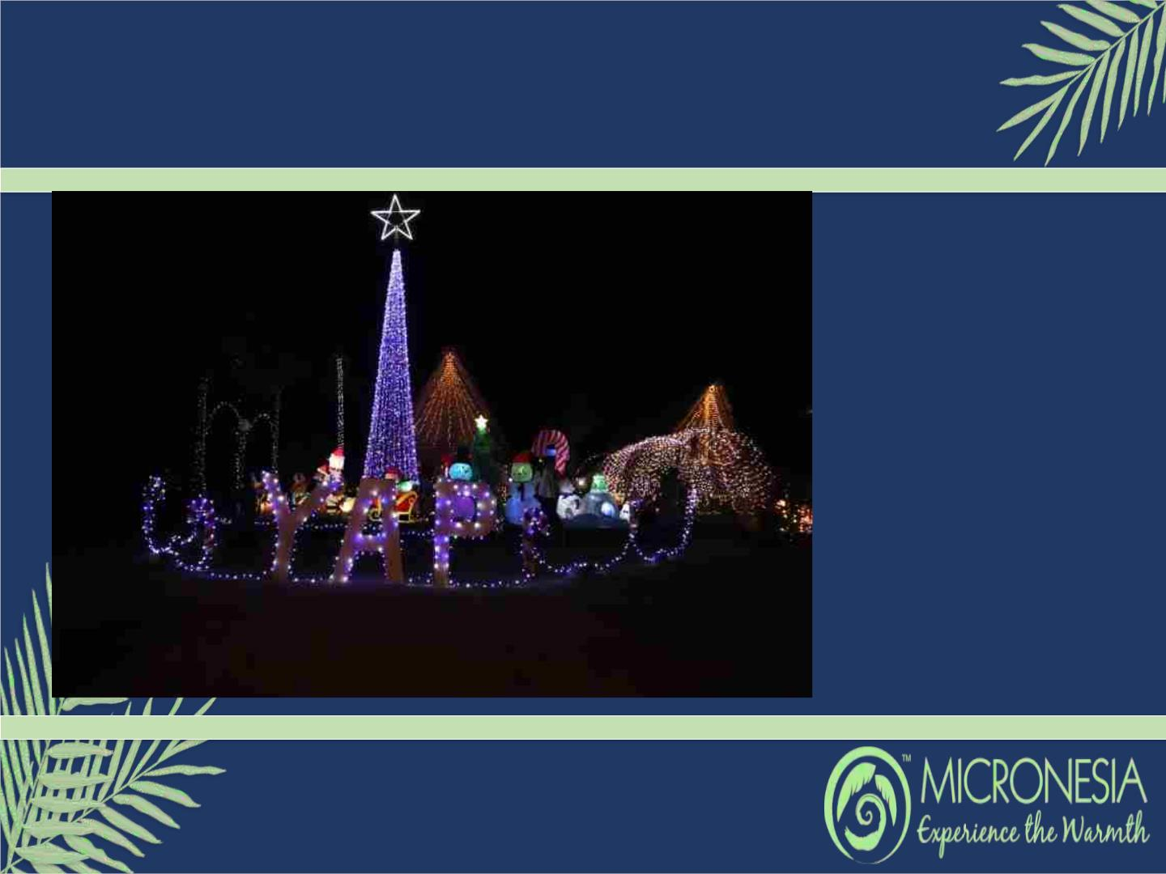
Christmas Night Market &
Santa Clause Coming to Town
Yap Visitors Bureau is happy
to announce the Christmas
Night Market that will be held
at the Yap Living history
Museum starting on
December 19th-23rd at 6pm.
This Night Market presents;
Local cuisines, local treats
and better yet engage with the
local people.
Oh oh oh! Santa Clause
coming to Colonia town. On
December 23rd at 7pm, Santa
Clause will be visiting the Yap
Living History Museum to
spread joy and tons of treats.
Have a wonderful and safe
Holidays!

